Slide 1


Preparing for Rubin LSST with DECam Data: Mapping Stellar Populations in
the Carina Nebula
Author:
Alessandro Salvatore Tramuto (University of Palermo-UNIPA; INAF-OAPa; Rubin LSST TVS-SC)
Co-Authors:
Rosaria (Sara) Bonito (INAF-OAPa, Italy; Rubin LSST TVS-SC)
Laura Venuti (SETI Institute, California, USA; Rubin LSST TVS-SC)
Costanza Argiroffi (University of Palermo-UNIPA; INAF-OAPa)
Marco Miceli (University of Palermo-UNIPA; INAF-OAPa)
Patrick Hartigan (Rice University, Houston, TX; Rubin LSST TVS-SC)
Shaping the Future of Time-Domain Astronomy with LSST (May 19-23, 2025)

Slide 2
Outline:
DECam survey of Carina Nebula
Photometric Catalog of the brightest stars in Carina (and time series)
Preliminary Results in the control field (Tbox) vs the whole field
  Photometric Catalog
  DECam Light Curves
Characterization of the time-averaged photometric catalog
  Astrometric Accuracy of DECam catalog
  Clustering in Carina
Next steps and comparisons with Rubin LSST
Future perspectives/goals with Rubin LSST
alessandro.tramuto@inaf.it (UNIPA; INAF-OAPa)

Slide 3
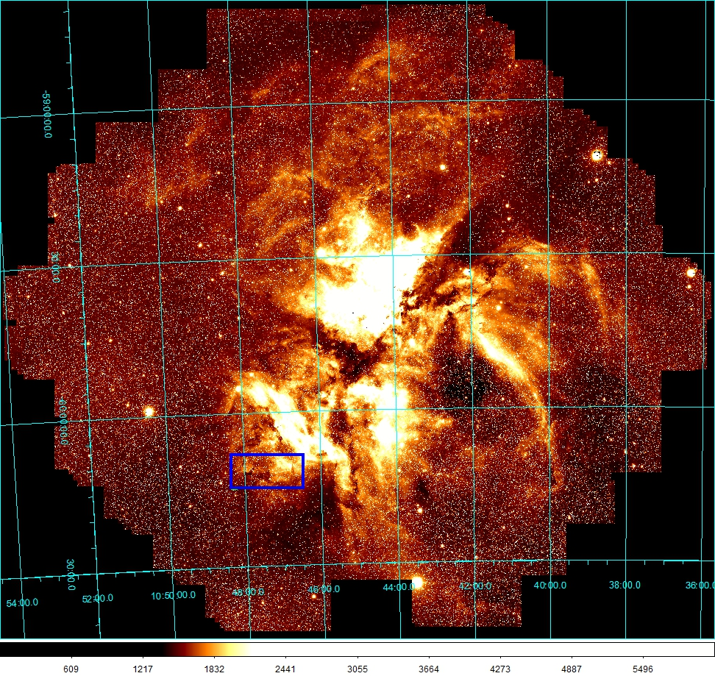
Carina Nebula composite image
DECam survey of Carina Nebula
We created the most complete stellar census of Carina Nebula using:
The DECam z filter (+ u, g, r, i)
21 consecutive nights of observation
Cadence: down to 20 minutes
Exposure times: 60 s, 8 s, 1 s, 0.1 s, 0.01 s
(observing program 2019A-0101; PI: P. Hartigan)
Control Field (Tbox)
alessandro.tramuto@inaf.it (UNIPA; INAF-OAPa)

Slide 4
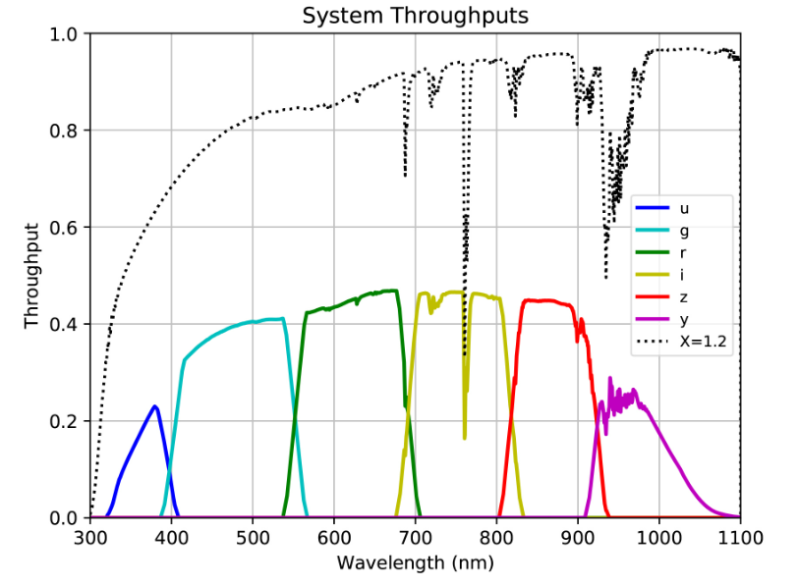
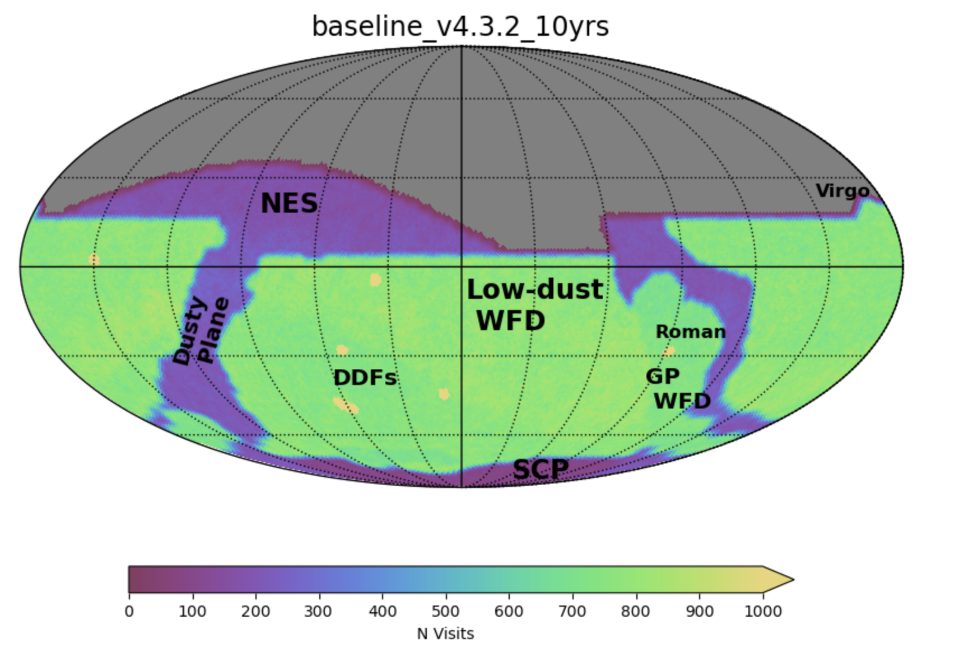
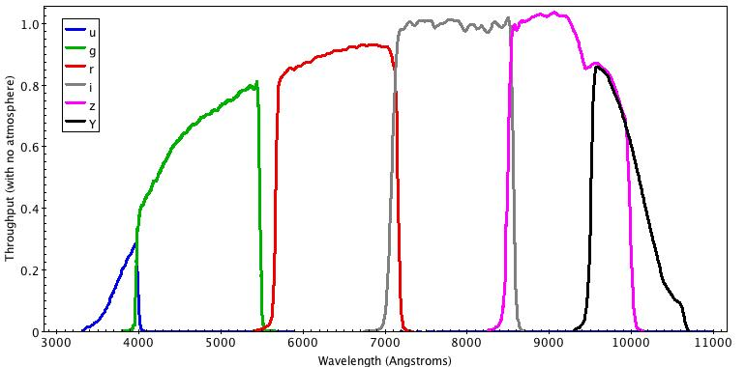
Rubin LSST bandpasses reference: Ivezić et al. 2019
Rubin LSST baseline reference: USDF MAF
DECam bandpasses reference link
alessandro.tramuto@inaf.it (UNIPA; INAF-OAPa)

Slide 5
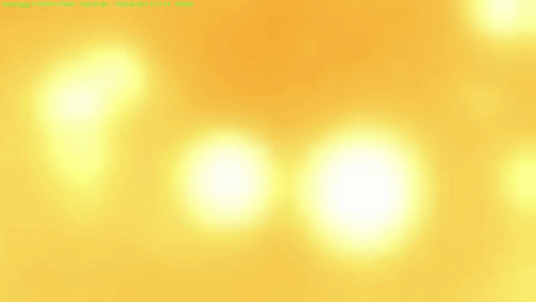
alessandro.tramuto@inaf.it (UNIPA; INAF-OAPa)

Slide 6
Photometric Catalog of the brightest stars in Carina
10ms stacked image of 21 nights in DECam z filter
zero-point correction image
Source Detection and PSF Photometry
And extend to the time series:
Use single-frame images
Forced-position PSF Photometry
IDs Light Curves (also done for 100ms exposure)
alessandro.tramuto@inaf.it (UNIPA; INAF-OAPa)

Slide 7
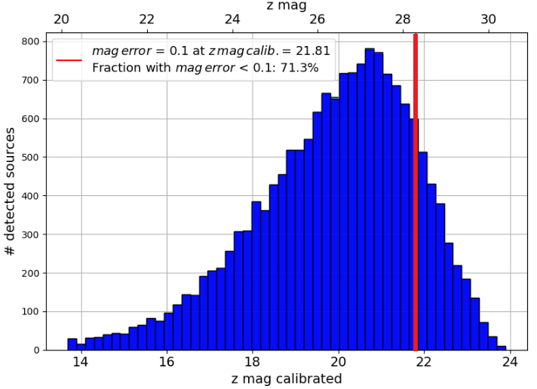
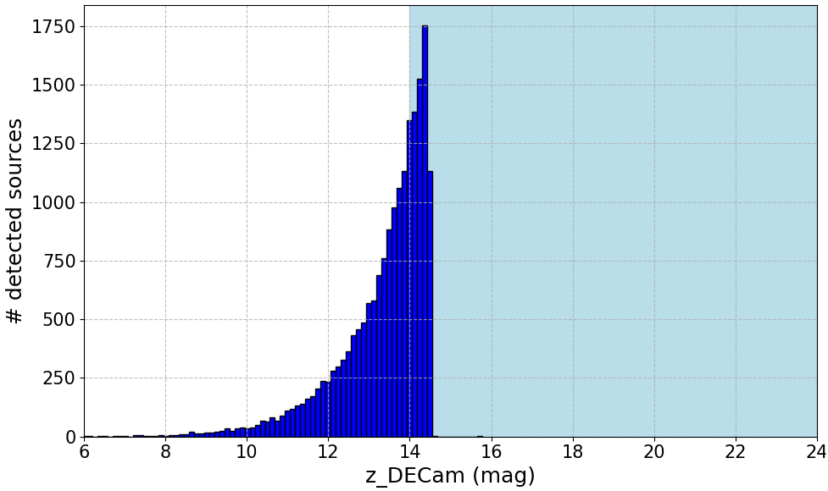
Preliminary Results:
Photometric Catalog
60s exposure
Tbox
We obtained the deepest stellar census of this field in Carina: 4.8M stars (astrometry in the z band)
Tramuto et al. A in prep.: We expect even more sources + time series!
10ms exposure
All field
In the Tbox we got 16k sources with PSF photometry, just from the 60s exposures
alessandro.tramuto@inaf.it (UNIPA; INAF-OAPa)

Slide 8
Preliminary Results:
Photometric Catalog
60s exposure
Tbox
The catalog will contain:
Faint sources up to 24 mag (or more)
Bright ones down to 6-8 mag
We will get a [ 6 - 24 ] mag catalog, in z, with high cadence time-series data of most of the stars.
10ms exposure
All field
alessandro.tramuto@inaf.it (UNIPA; INAF-OAPa)

Slide 9
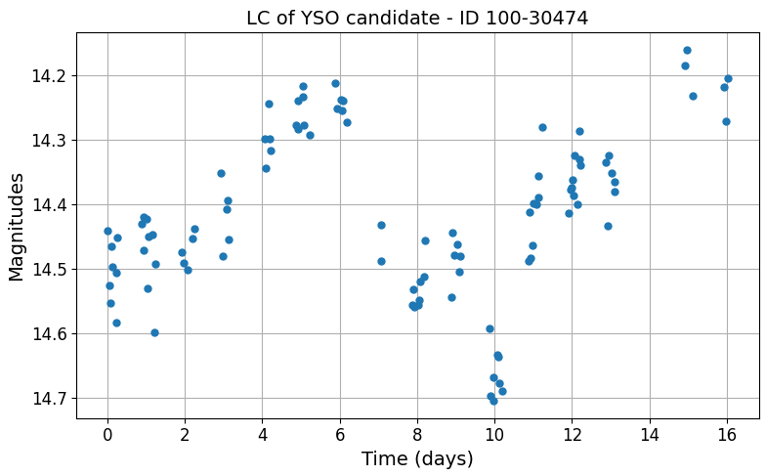
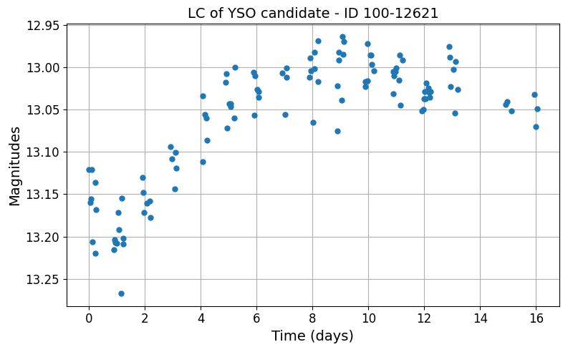
Preliminary Results:
DECam Light Curves (LCs)
One main goal of this survey is to visualize all kinds of temporal variability:
From minutes/hours up to weeks
In a total of 21 successive nights
Two LCs of YSOs matching with MYStIX
Scientific applicability of the catalog:
not only for YSOs, but for all the variable sources that show variability in these time scales
Observable in z
Tramuto et al. B in prep.:
We aim to improve the catalog also adding u,g,r, and i
alessandro.tramuto@inaf.it (UNIPA; INAF-OAPa)

Slide 10
Characterization of the time-averaged photometric catalog
We analyzed accuracy and properties of the catalog for 10ms
Photometric cross-match with:
Gaia DR3 (Vallenari et al. 2022), for astrometric precision
  16.4k matches out of the 18.7k DECam bright sources (10ms)
MYStIX (Povich et al. 2013), to mark Young Stellar Objects (YSO)
  >230 YSOs candidates matching with DECam bright sources (10 and 100ms)
We also found >250 more YSOs candidates using 5D DBSCAN for clusters (more later)
Work in progress: higher exposures
Tramuto et al. B in prep.:
YSO detection and analysis using both time-averaged and time-series catalogs
alessandro.tramuto@inaf.it (UNIPA; INAF-OAPa)

Slide 11

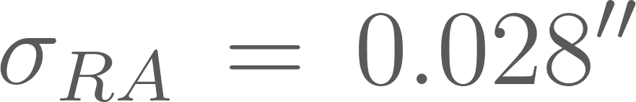
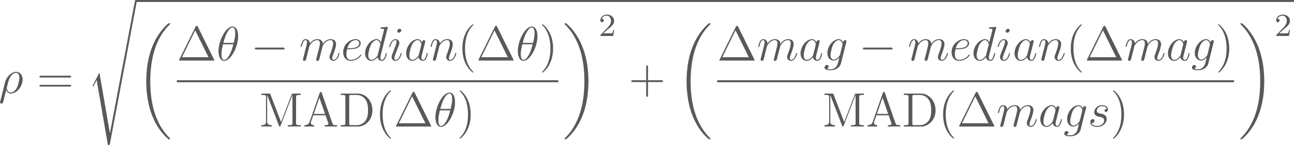
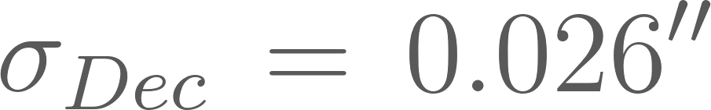
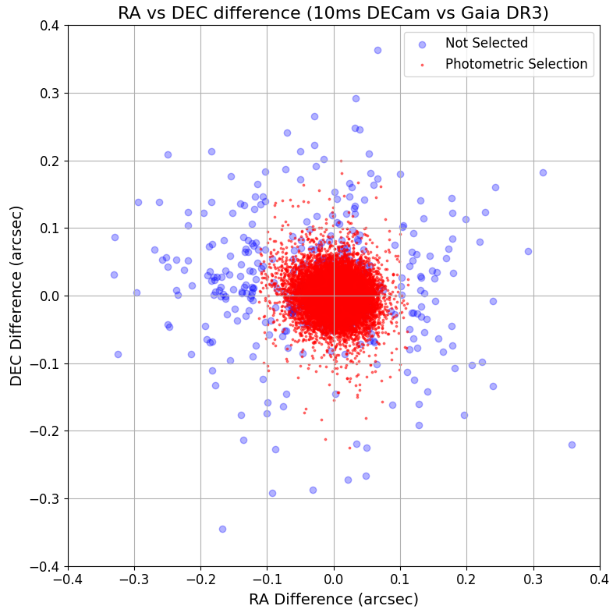
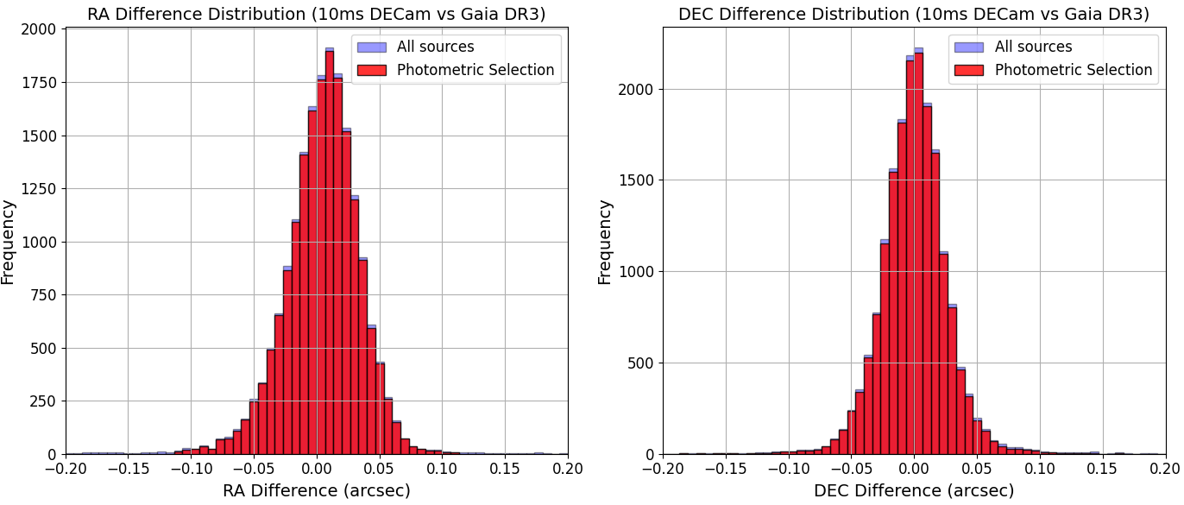
Astrometric Accuracy of DECam catalog (10ms exposure)
Photometric cross-match filters out some of the mismatches
(metric form Gavras et al. 2023)
Gaia DR3 matches used to evaluate
alessandro.tramuto@inaf.it (UNIPA; INAF-OAPa)

Slide 12
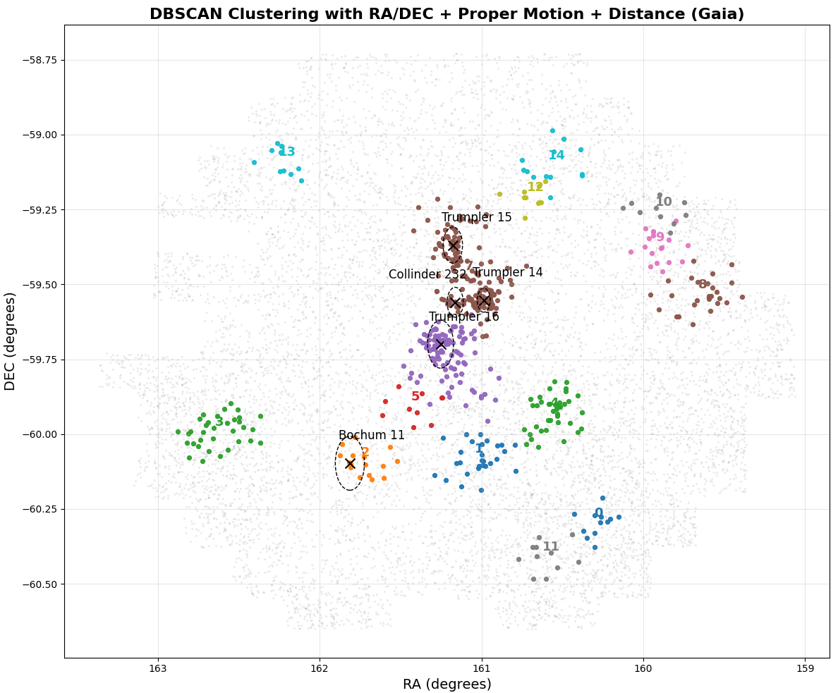
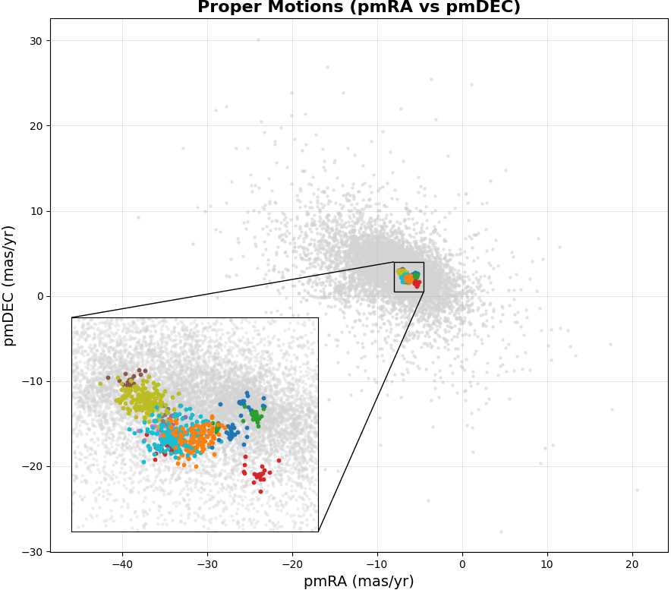
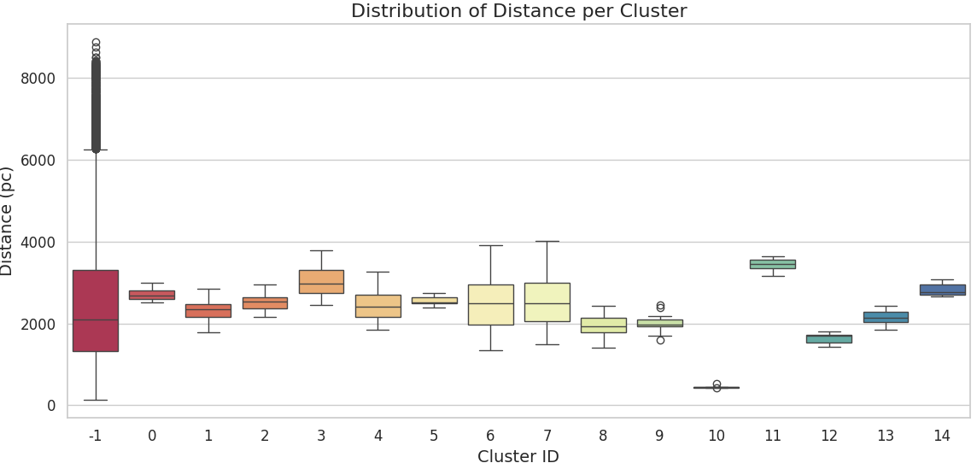
5D clustering in Carina
To map stellar populations in Carina we studied clusters in this region using DBSCAN
These are the results focusing on proper motion and the distance (pc)
15 clusters found (5 known)
alessandro.tramuto@inaf.it (UNIPA; INAF-OAPa)

Slide 14
5D clustering in Carina
The 5 known clusters are confirmed by both methods
At least 9 new cluster candidates in this area (>250 stars)
These results come from the 10ms exposure images only
Tramuto et al. A in prep.:
After completing the catalog for fainter stars, we will use a much larger and diverse sample of data for this analysis
alessandro.tramuto@inaf.it (UNIPA; INAF-OAPa)

Slide 15
Next steps and comparisons with Rubin LSST
These are preliminary results from the brightest stars of the catalog (from 10ms exposures)
Astrometry of 4.8M stars in the z band, photometry and time series will come next
The goal then is to approach the u, g, r, i filters
This survey will serve not only for YSOs research, but for many scientific topics
It is a good example for a Rubin LSST microsurvey, to study rapidly-varying sources in Star-Forming Regions
The high field of view and speed of Vera C. Rubin can be used to obtain a catalog even deeper than this with less effort and time, with respect to DECam
Proposals like this one can be found in:
  Bonito & Hartigan 2018
  Bonito & Venuti et al. 2023
The Rubin LSST Baseline will not be enough, a microsurvey is needed to obtain LCs of these rapidly-varying sources
alessandro.tramuto@inaf.it (UNIPA; INAF-OAPa)

Slide 16
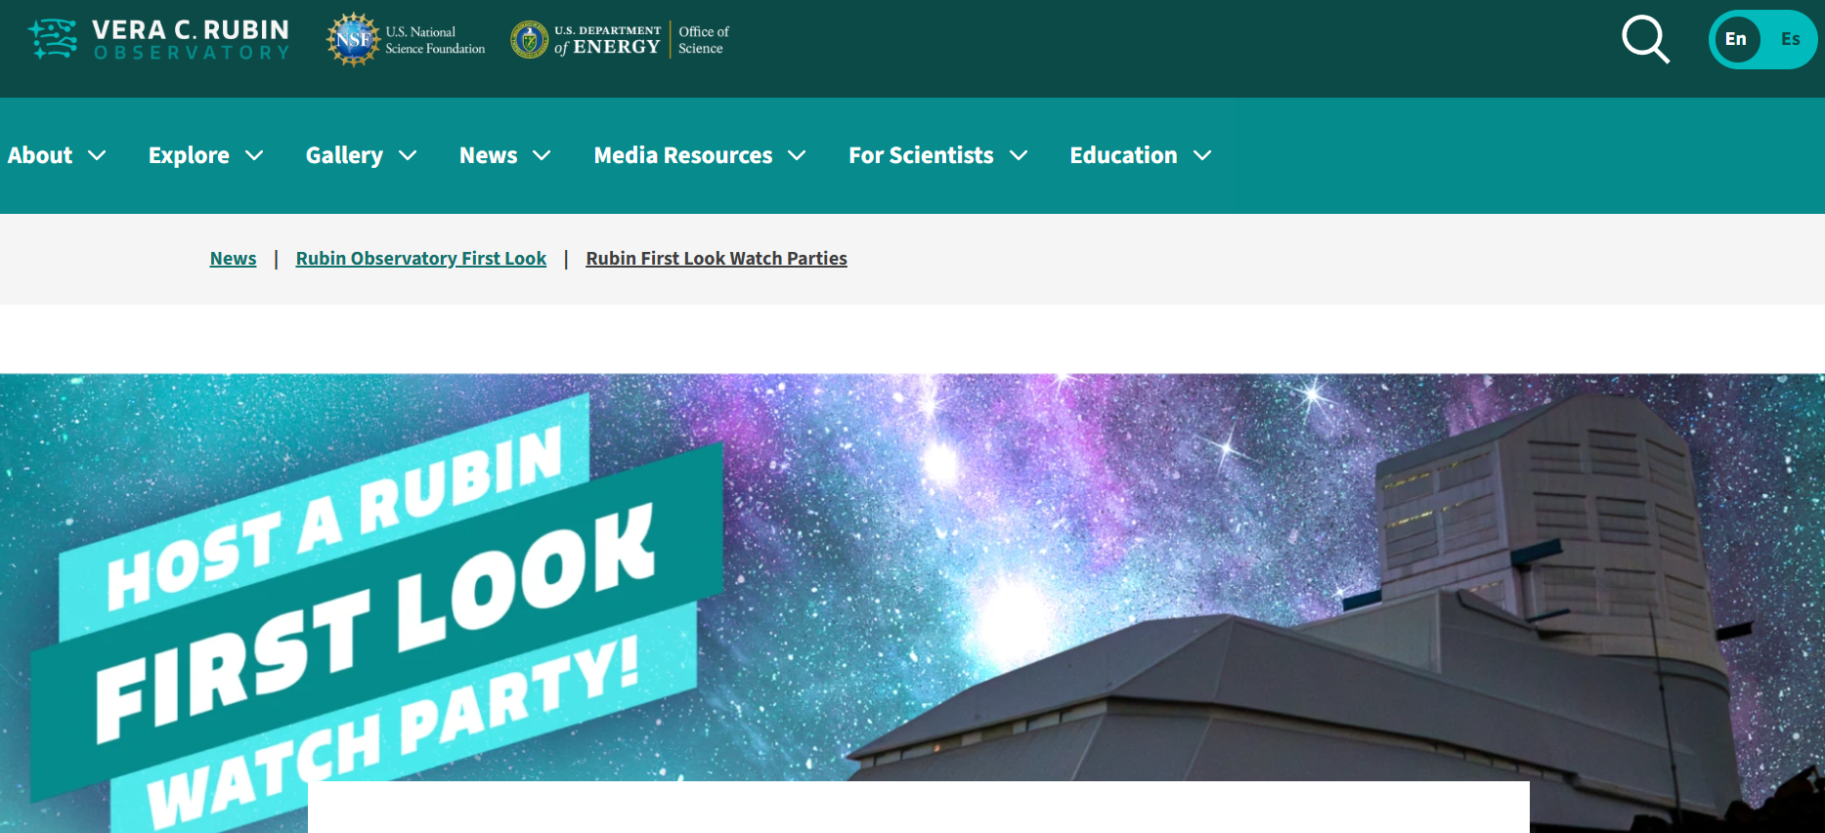
Future perspectives/goals with Rubin LSST
Rubin LSST strategy high cadence for a dense sampling of short term variability
Time scales: From hours to a decade
Greatly increase the extent of the stellar catalogs with YSO candidates
LOC member for the Italian Rubin First Look Watch Party, to be held in Palermo!
https://rubinobservatory.org/news/rubin-first-look/rubin-party
alessandro.tramuto@inaf.it (UNIPA; INAF-OAPa)

