Slide 1
objective
Evaluate the risk of stellar contamination in spectrophotometric data collected by space instrument
Motivation
Nearby stars within the 47″ field of view may contribute unwanted flux, affecting photometric accuracy.
Accurate contamination assessment is critical for detection.
Approach
Developed a dedicated tool (Contaminator Analyzer) for automated contamination evaluation.
Used the Gaia DR3 catalog for its high precision and completeness (down to G ≈ 21).
Focused on stars in the MAUVE field of regard (Dec from −47° to +33°).
Identified potential contaminants with Δmag < 5, corresponding to ≥1% flux contamination.

Slide 2
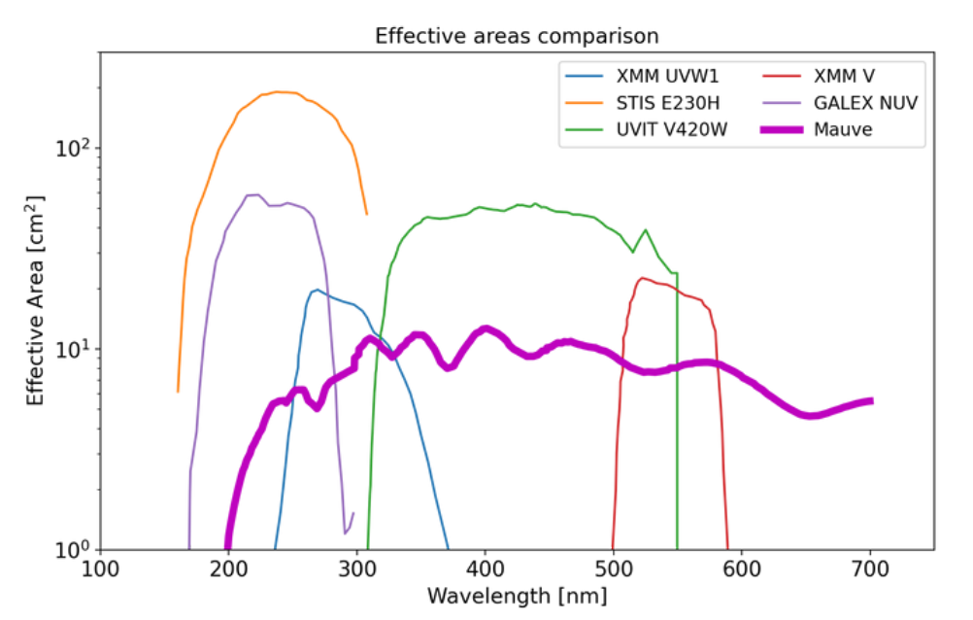
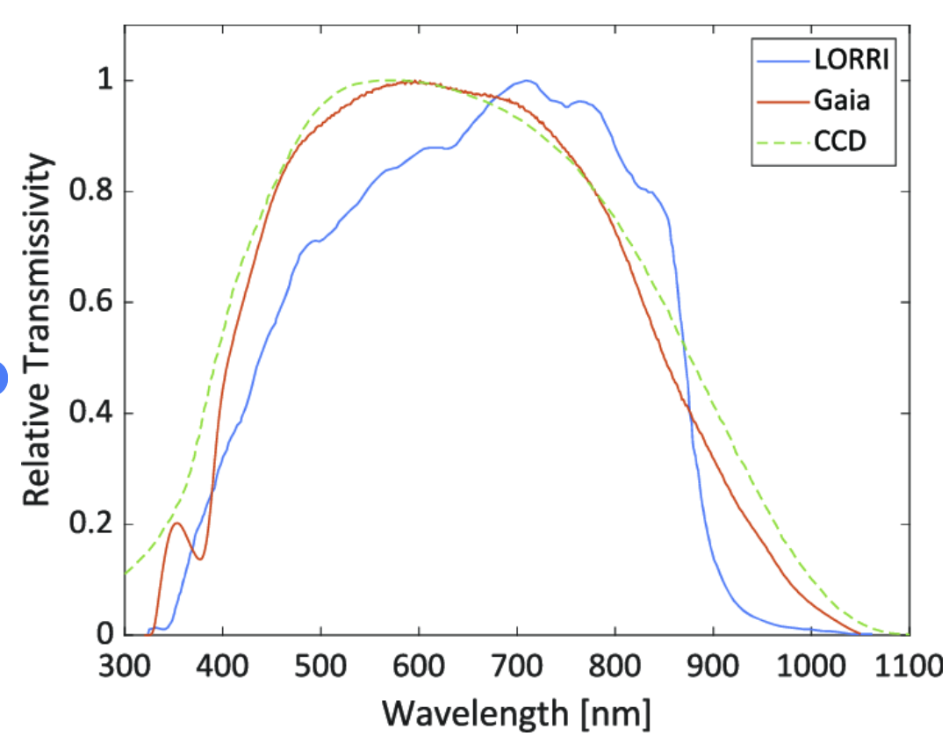
Mauve mission

Slide 3
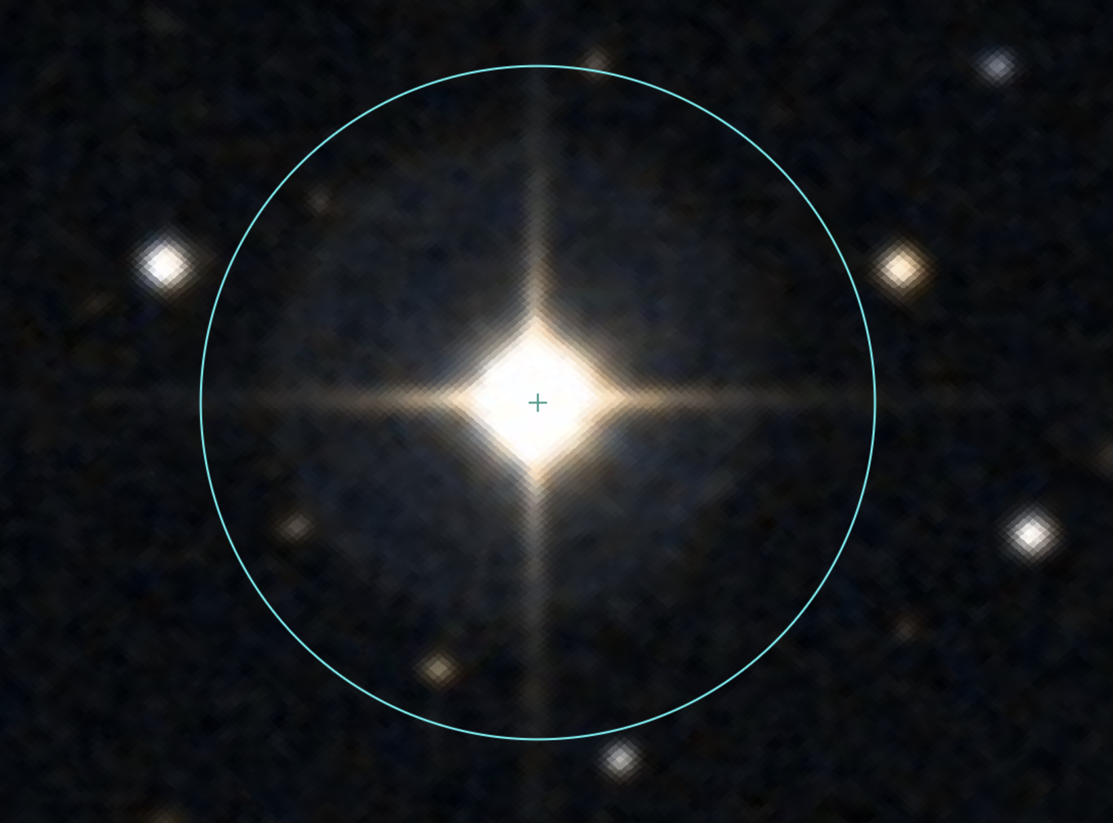

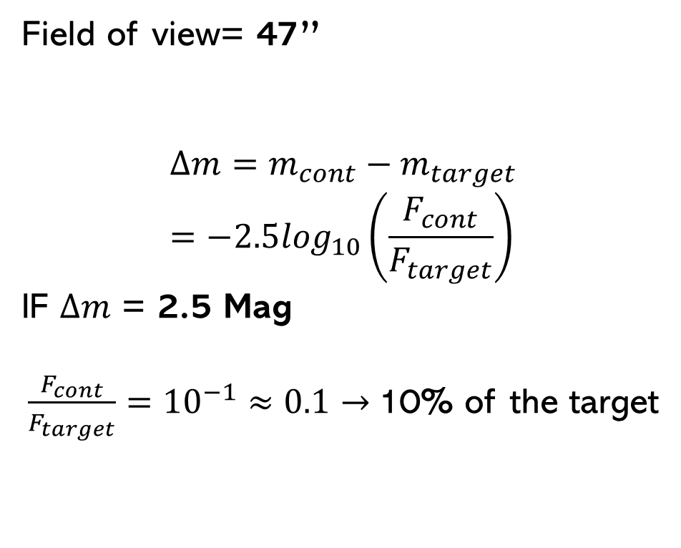
COntamination
Field of view= 47’’
$$Δm=m_{cont}−m_{target}=−2.5\log_{10}\left(\frac{F_{cont}}{F_{target}}\right)$$
IF $Δm$ = 2.5 Mag
$\frac{F_{cont}}{F_{target}}={10}^{−1}≈0.1→$10% of the target
47’’
In our case I use GAIA MAG

Slide 4

FLUX COntamination
$$Flux {Fraction}_{extra}=\frac{\sum_{i}{F_{i}}}{F_{target}}×100$$
Where:
$F_{i}={10}^{−0.4∙m_{i}}$ is the flux of the i-th contaminating star.
$F_{target}={10}^{−0.4∙m_{target}}$ is the flux of the target star.
Example:
If one contaminant has a magnitude 2.5 fainter than the target, it contributes ~10% of the target’s flux.
If several faint stars are present, their cumulative flux can still be significant.
47’’

Slide 5

TOOL
INPUT
CATALOG
There are any objects in the field of view of the target?
Free parameters:
Field of view
ΔMAG
CONTAMINANT SEARCH
NO
YES
Object non contaminated
NO
Are there any within the ΔMAG?
YES
Object contaminated
OUTPUT:
CATALOG OF STARS WITH:
CONTAMINANTS
FLUX FRACTION EXTRA
MINIMUS SEPARATIONS FROM THE NEAREST CONTAMINANT

Slide 6
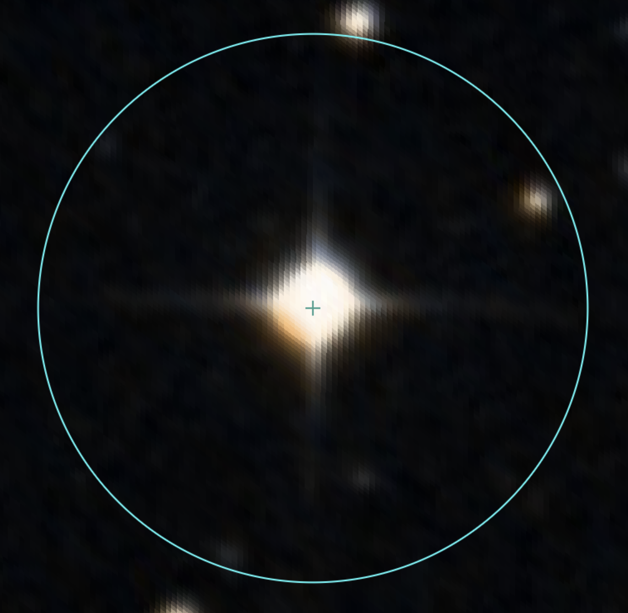
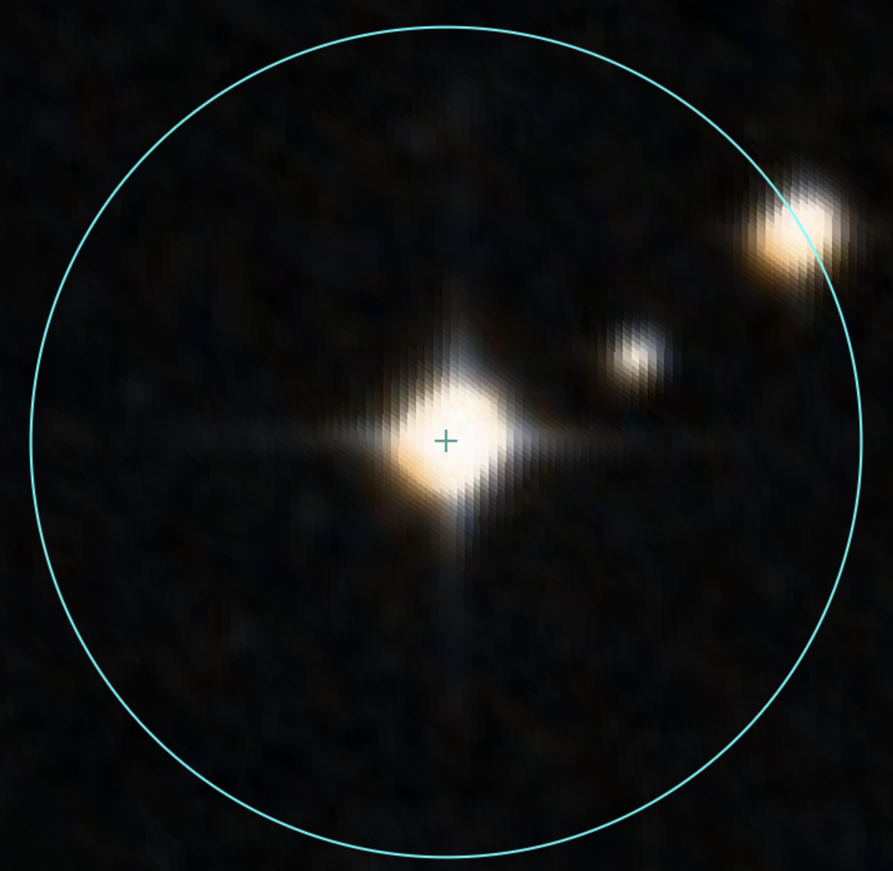
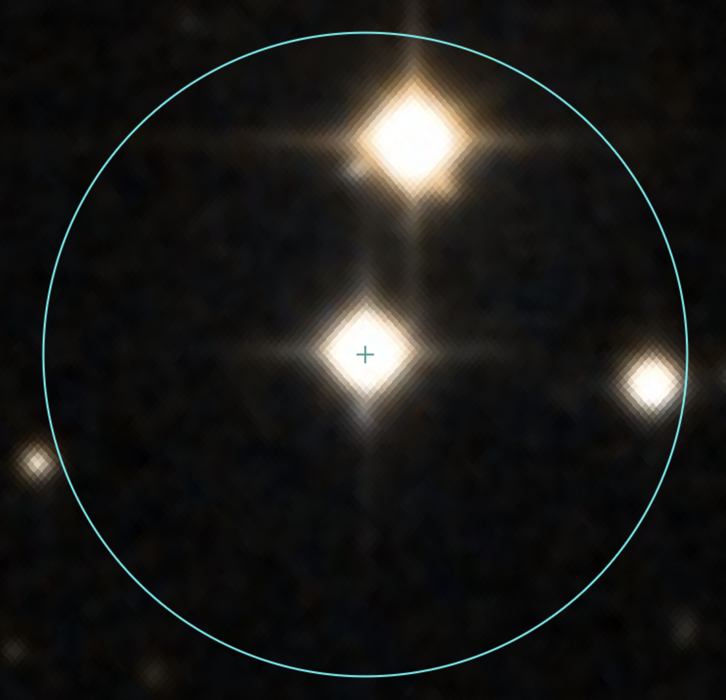
Examples of contamination
Non-contaminated
0 contaminant
Contaminated
1 contaminant
Contaminated
3 contaminant
Gaia DR3 3217815512782099968
Gaia DR3 3217804101053283840
Gaia DR3 3217804105348957696
Gaia DR3 3217804105348957696
Gaia DR3 3217804169772760576
Gaia DR3 3217804174069106688
Gaia DR3 3217804101053283840

Slide 7
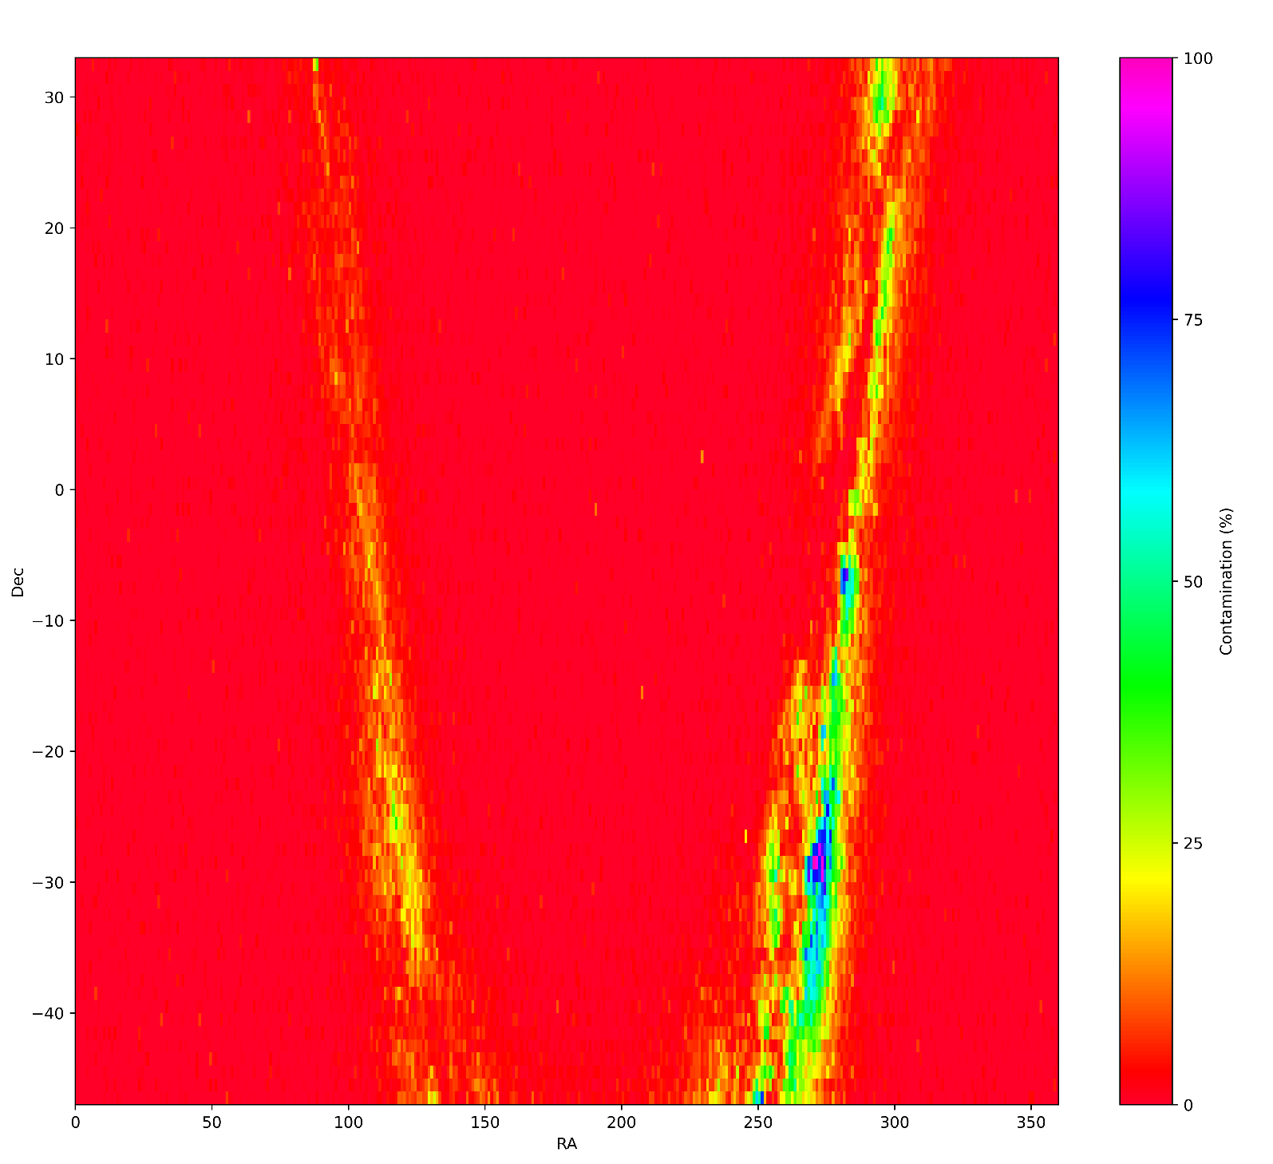
Contamination map
47 arcsec
2.5 ΔMAG
MAG MIN=No limit
MAG MAX=12
-47 < Dec < 33
0 < RA < 360
Galletta et al. In prep.

Slide 8
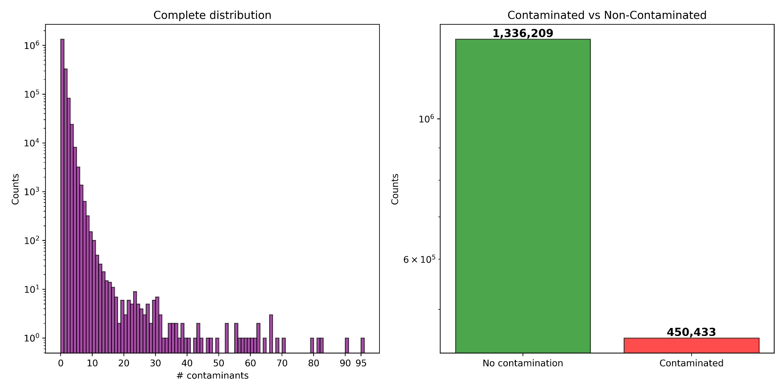
Contaminants distributions
Galletta et al. In prep.

Slide 9
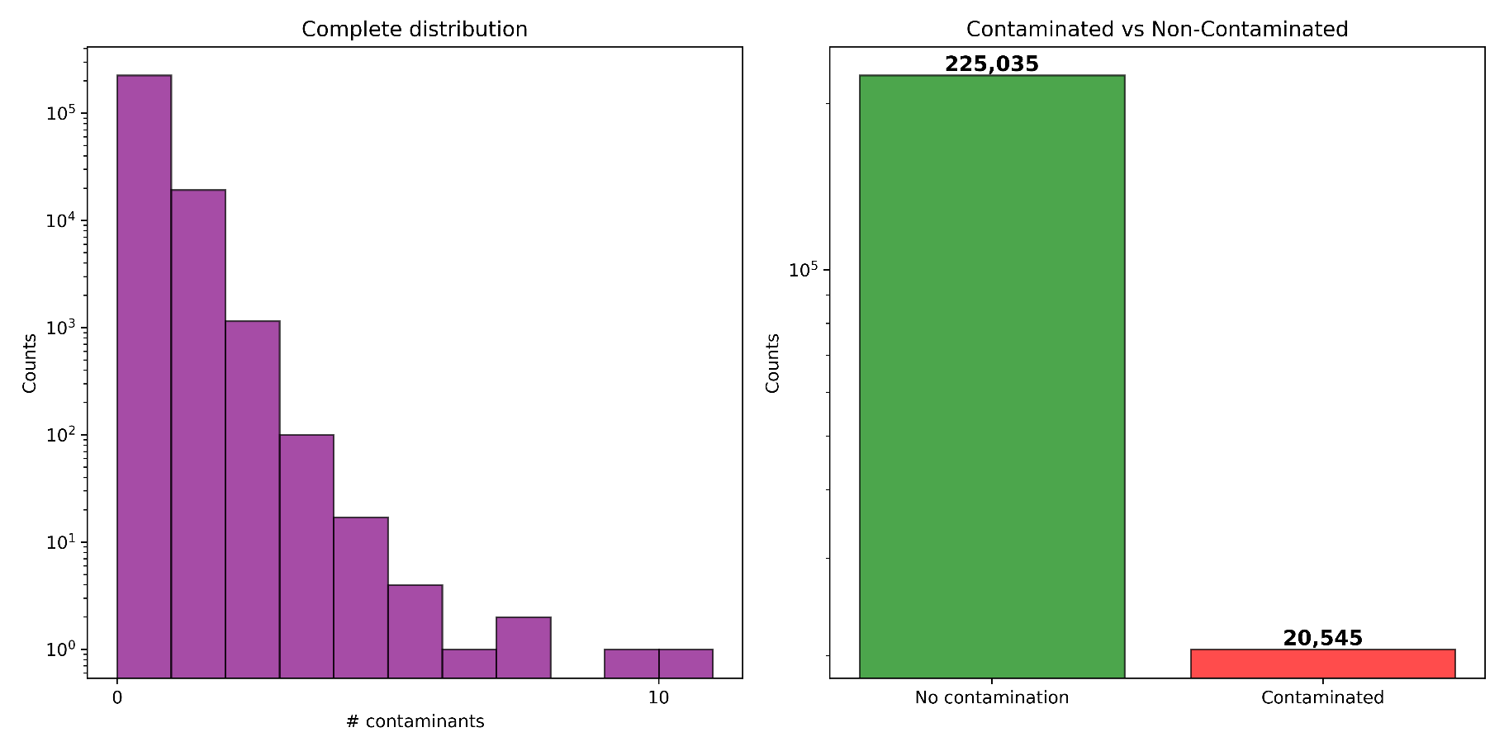
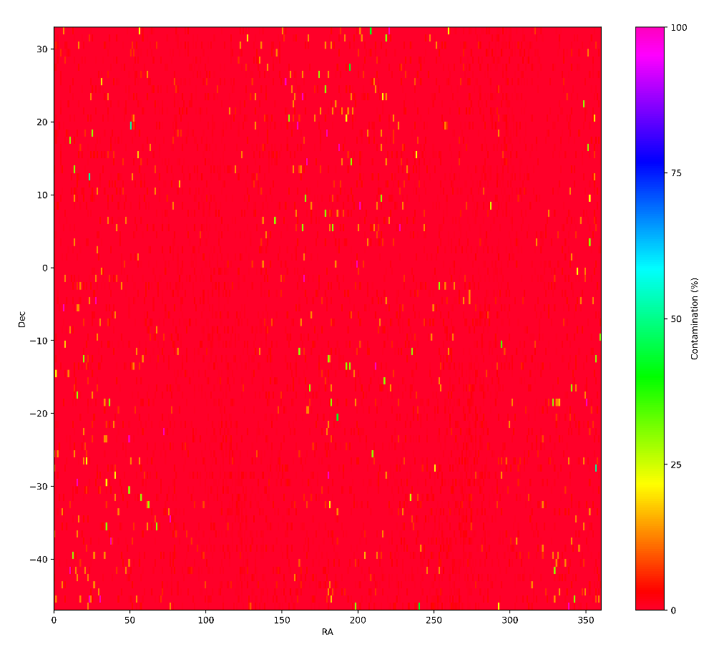
Contamination
Galletta et al. In prep.
47 arcsec, 2.5 ΔMAG, MAG MIN=8, MAG MAX=10

Slide 10

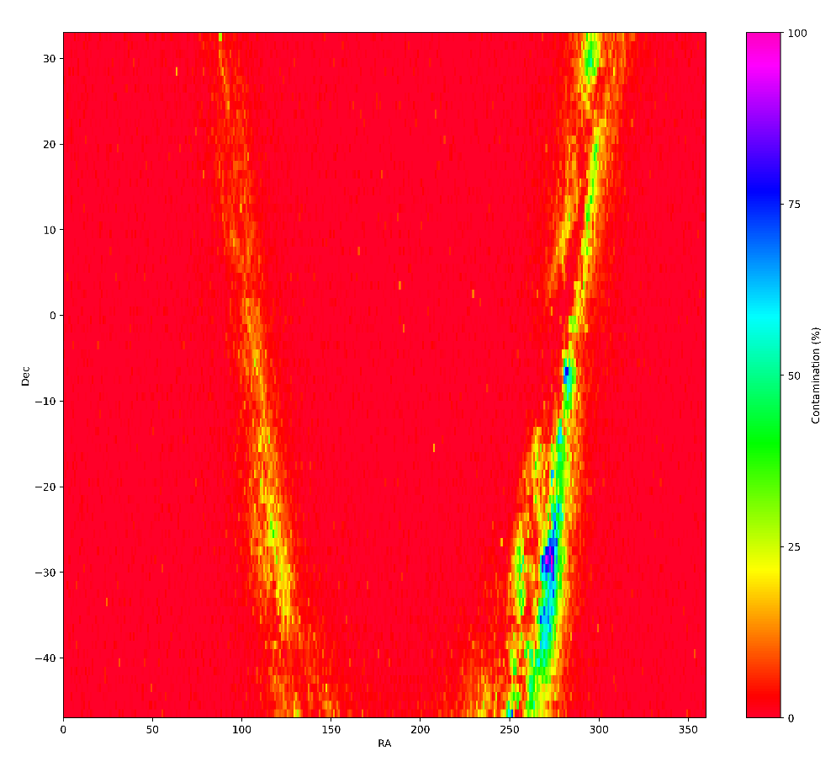
Contamination
Galletta et al. In prep.
47 arcsec, 2.5 ΔMAG, MAG MIN=10, MAG MAX=12

Slide 11
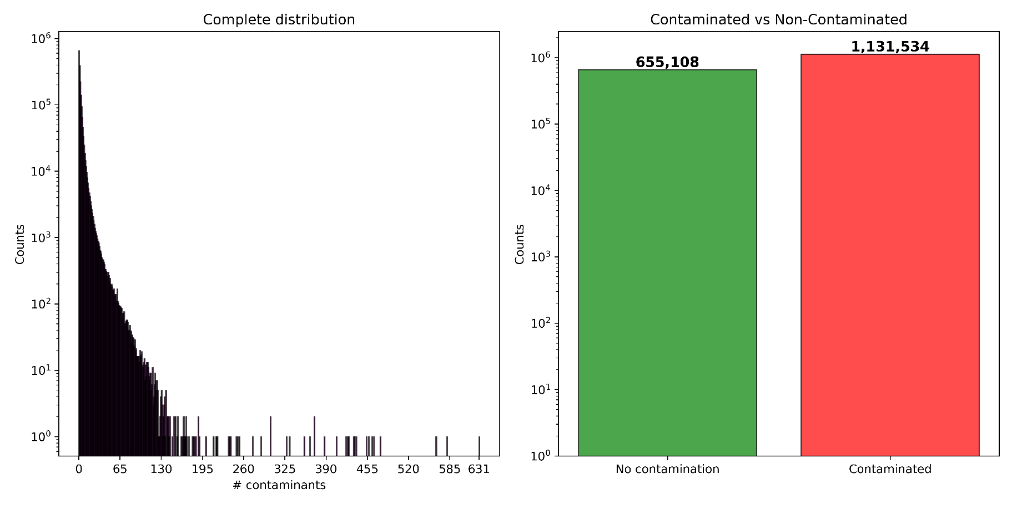
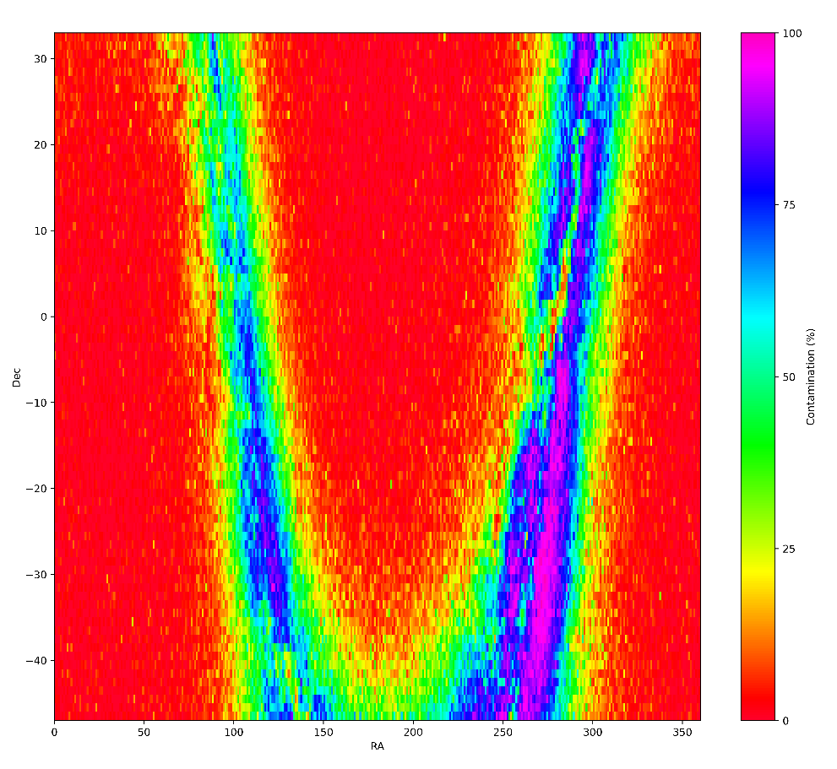
Contamination
Galletta et al. In prep.
47 arcsec, 5 ΔMAG, MAG MIN=No limit, MAG MAX=12

