Slide 1




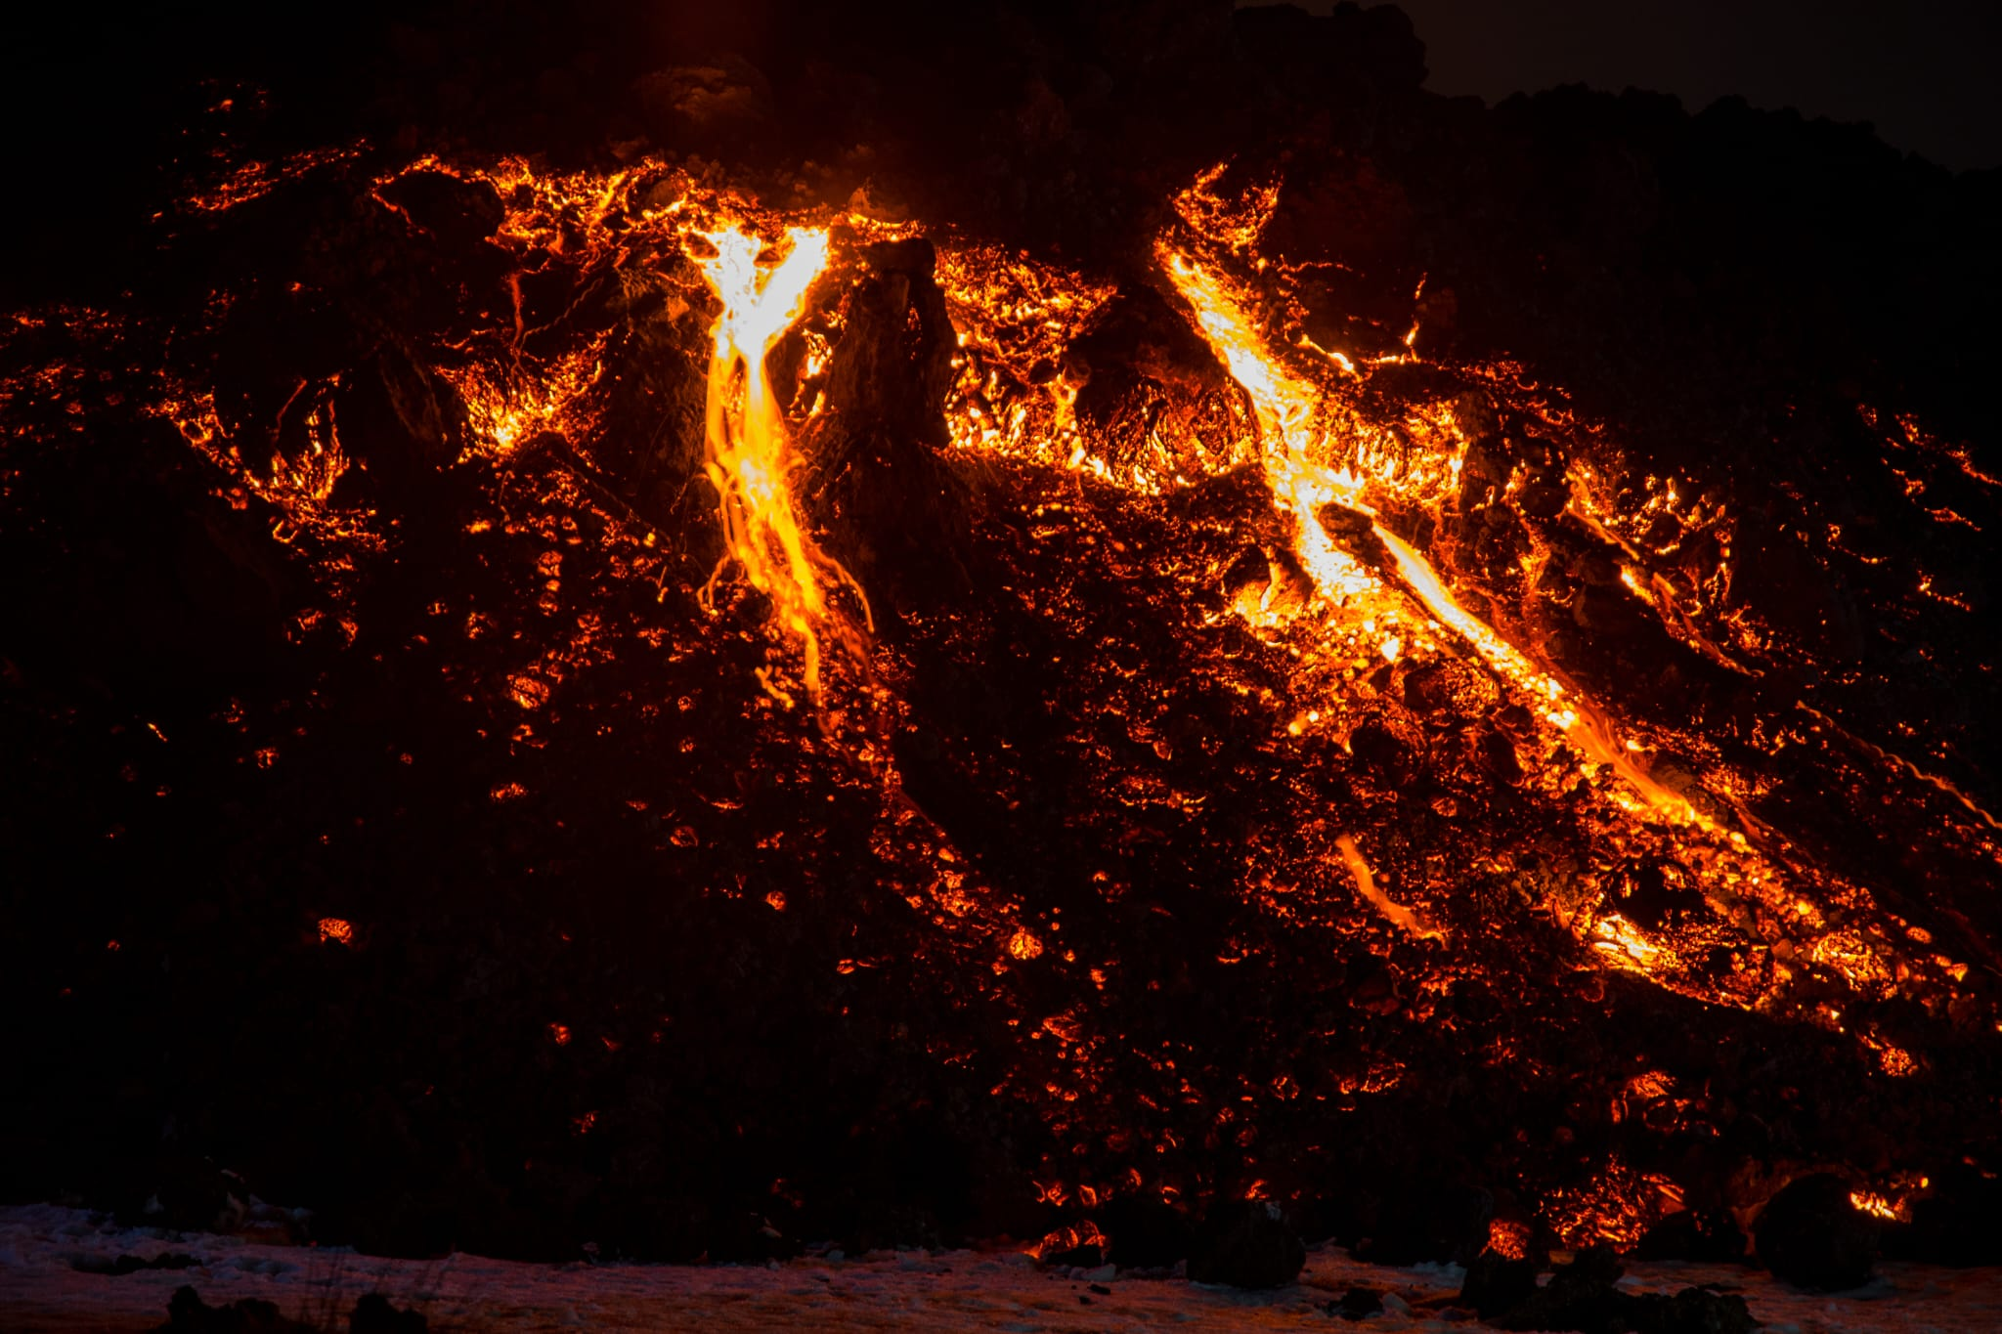
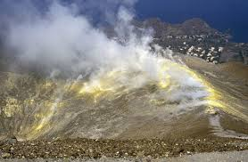
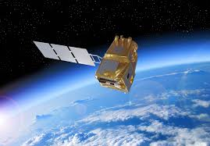
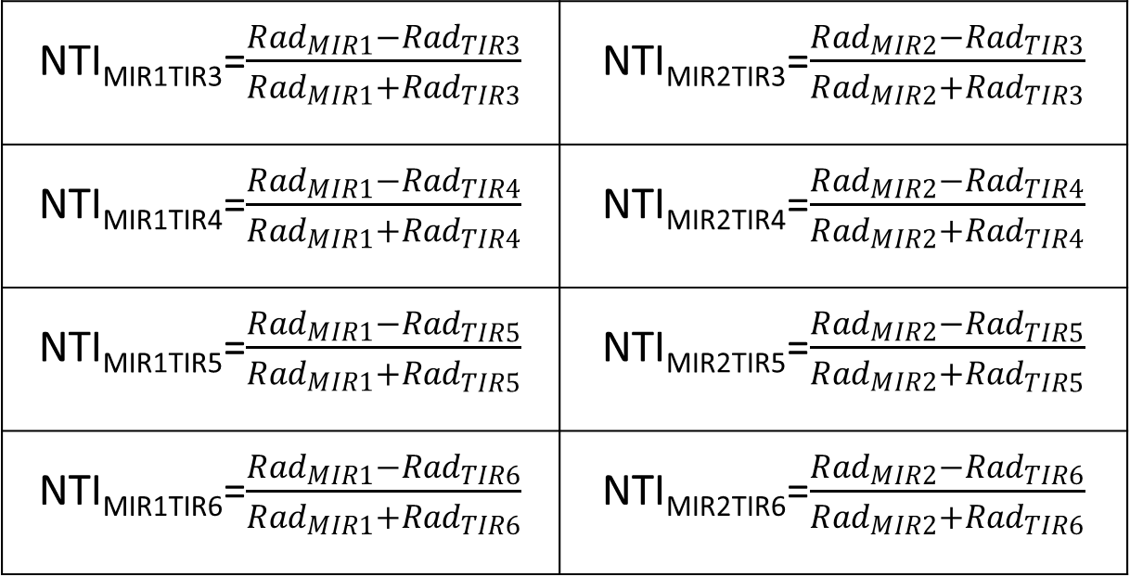
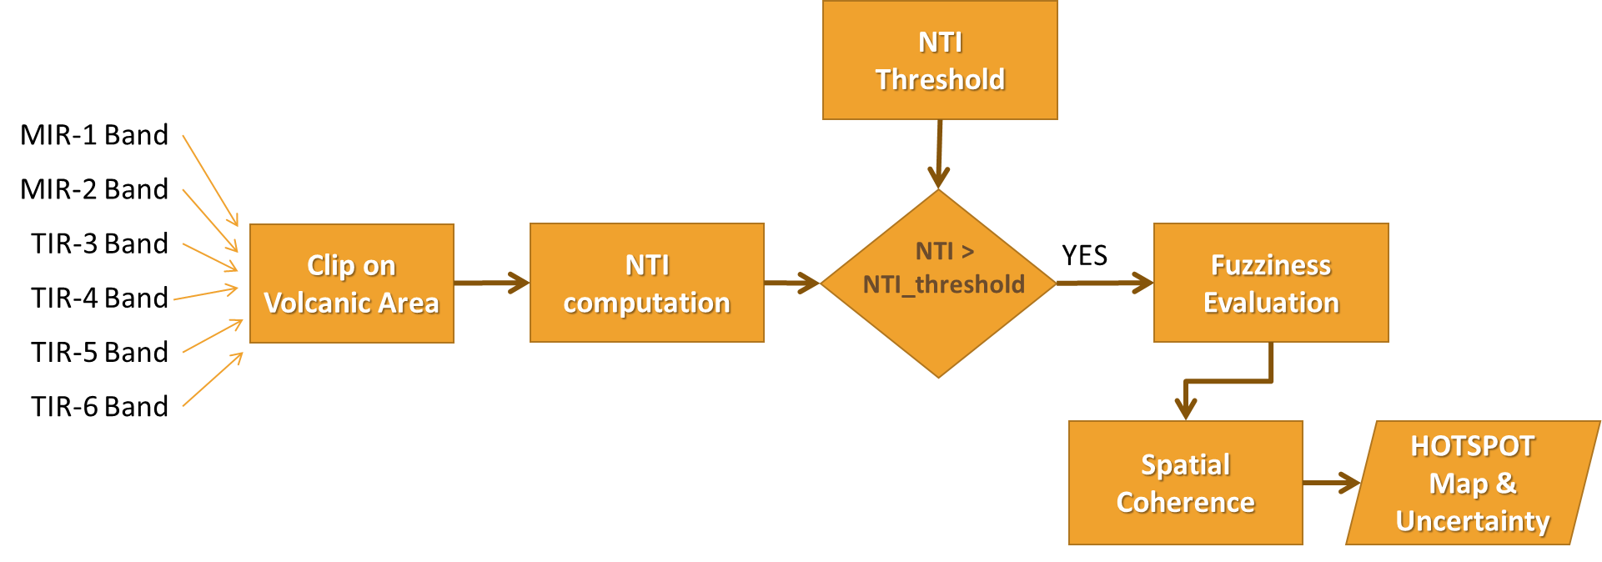
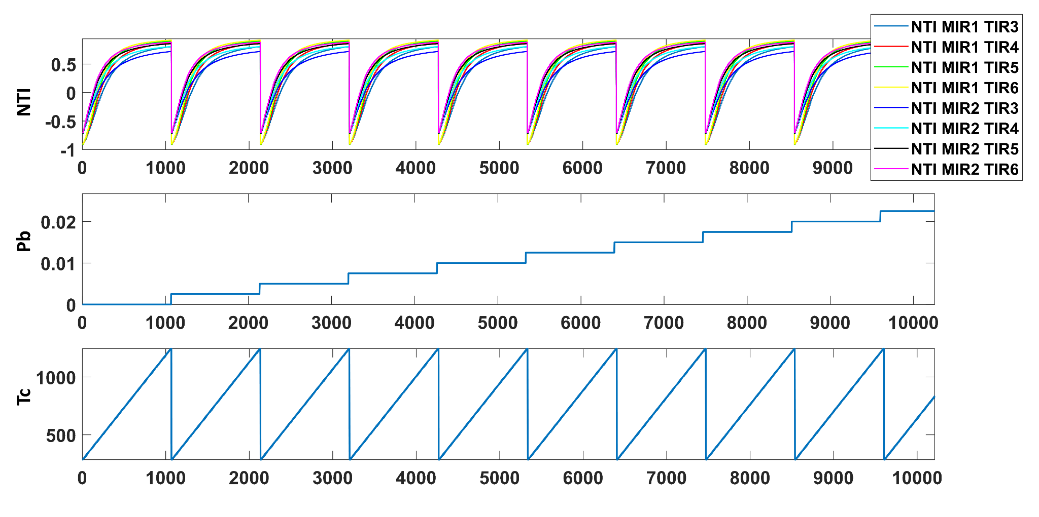
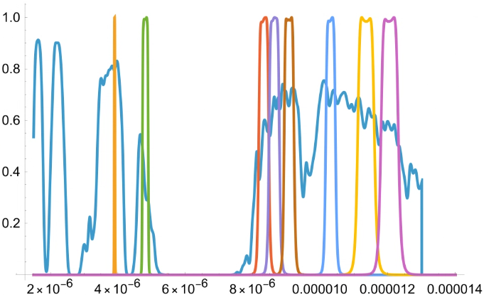
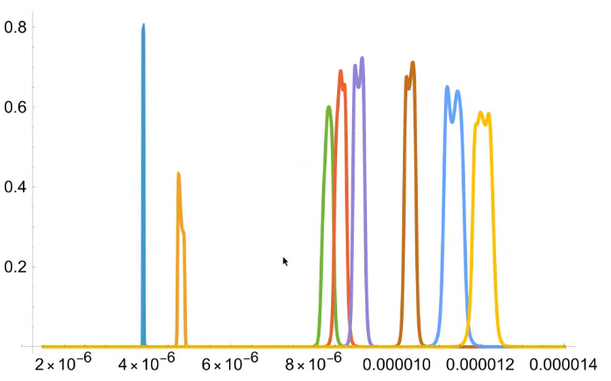
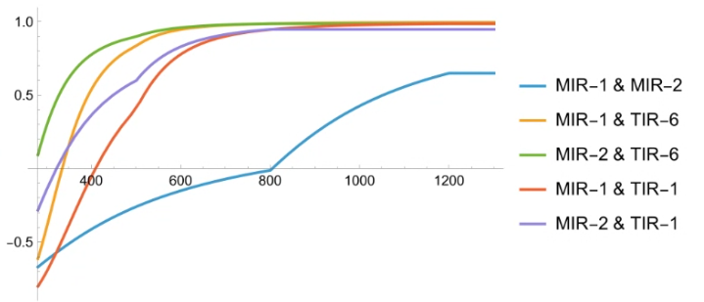
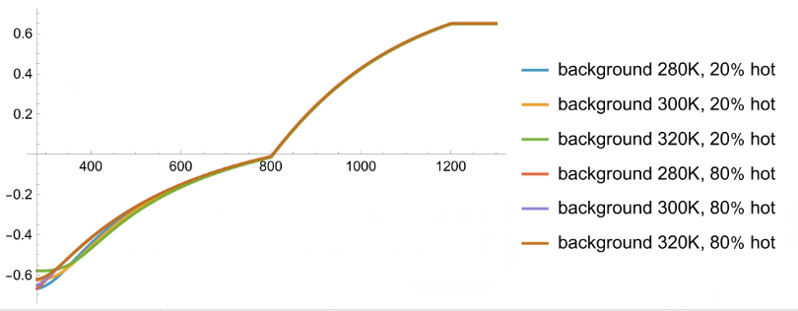
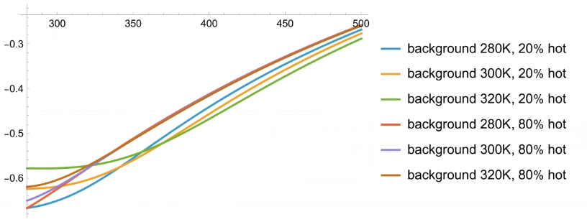
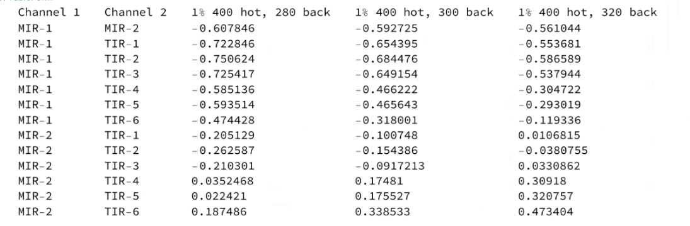
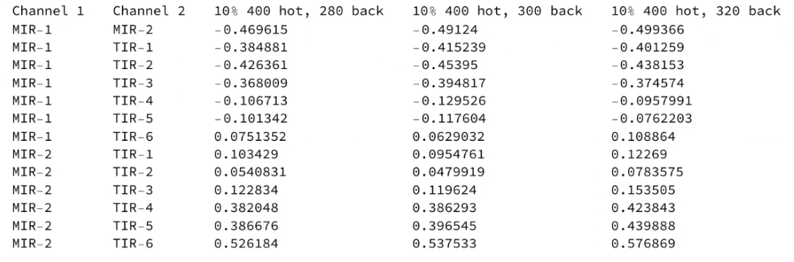
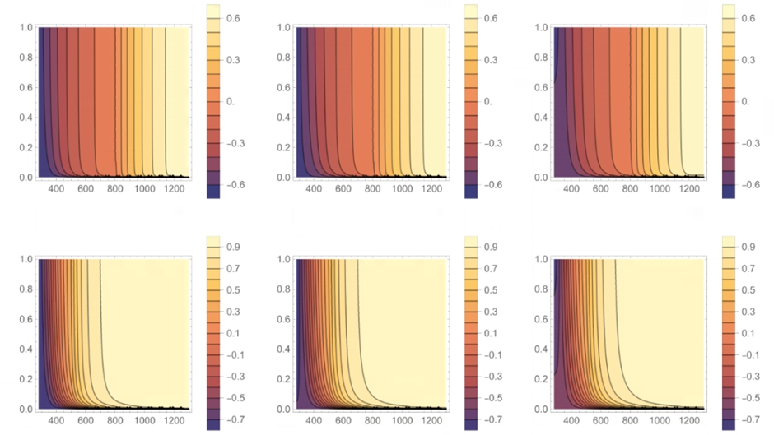
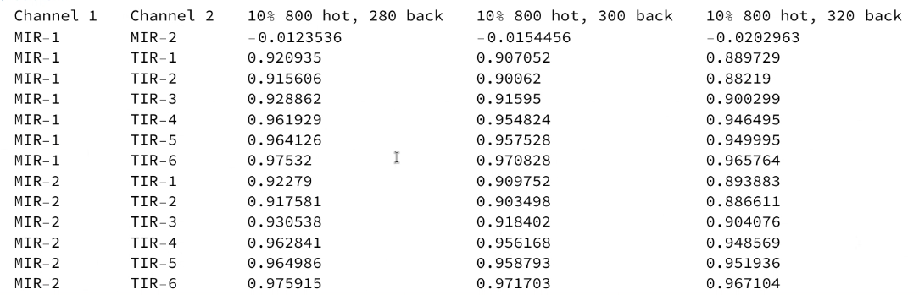

Leveraging the SBG-TIR Mission for Thermal Monitoring of Volcanoes
G. Ganci, G. Bilotta, A. Cappello, M. Dozzo, R. Guardo, M. Spina, F. Spina, F. Zuccarello
Istituto Nazionale di Geofisica e Vulcanologia, Osservatorio Etneo, Catania, Italy
Introduction
HTE | Temperature K | Area m2/km2 | Duration | Comments
Thermal anomaly (fumarole fields inside craters or on the flanks) | 283-360 | 10-10² m2 | 1h to >>day | Variable: from few hours to permanent fumarole fields
Lava flows | 800-1500 core Temp 300-700 crust Temp | 10²-10⁵ m2 | > day | Variable: from few hours to several days
Lava Fountains | 1000-1400 | 10³-10⁷ Kg*S⁻¹ | 5 min to 20 h | Mass flow rate MFR
Pyroclastic deposit | <1200 | 10³-10⁷ m2 | 1-20 h | Variable: few hours to several days in case of more episodes
Volcanic Plumes (ASH/SO2) | 1200 at vent Thermalized with atmosphere |  | 5min-15min (small eruptions) 1h to >> d large eruptions) | Eruptive plumes plumes have the temperature of atmosphere after few minutes from the emission
Thermal manifestations in volcanic areas span a broad temperature range, from warm hot springs at 30–60°C and boiling geysers near 100°C, to fumaroles exceeding 500°C, lava flows ranging between 700–1,200°C, and pyroclastic density currents that can reach temperatures of up to 1,000°C, illustrating the intense and varied geothermal activity associated with volcanism.
The forthcoming Surface Biology and Geology (SBG) thermal mission, developed by NASA-JPL and ASI, will feature a MWIR-LWIR sensor and a VNIR camera, enhancing volcano monitoring capabilities from space. Unlike prior missions, SBG-TIR will include six MIR-TIR bands at 60m spatial resolution, with high-temperature MIR bands (800–1200 K) and TIR bands (∼500 K), offering improved thermal detection, reduced data saturation and better repeat coverage (3–5 days). The study investigates SBG-TIR’s potential for detecting subtle thermal anomalies and estimating effusion rates in case of effusive eruptions.
Band | Wavelength [µm]
MIR-1 | 3.98
MIR-2 | 4.80
TIR-1 | 8.32
TIR-2 | 8.63
TIR-3 | 9.07
TIR-4 | 10.05
TIR-5 | 11.35
TIR-6 | 12.05
Objective: development of a hotspot detection algorithm using the medium and thermal infrared bands of the SBG-TIR payload.
Methods
We introduced nine normalized thermal indices (NTI) employing the two MIR and the four TIR bands and also the two MIR bands
${NTI}_{MIR1MIR2}$= $\frac{{Rad}_{MIR1}−{{Rad}_{MIR2}}_{}}{{Rad}_{MIR1}+{{Rad}_{MIR2}}_{}}$
Synthetic Pixels Generation
Detection of subtle thermal anomalies
Volcanic Radiative Power
In order to find good thresholds for NTI, about 16 millions of synthetic pixels possibly related with volcanic activity were simulated taking into account the theoretical spectral response function of the SBG-TIR sensor with varying thermal structures. Normalized Thermal Indices (NTIs) considering all the MIR and TIR band radiances were computed for each synthetic pixel. NTIs help distinguish thermal anomalies by weighting radiances in MIR, emphasizing lava flows over colder features, like clouds. Simulations revealed that the MIR band centered at 4,8 𝛍m is critical for detecting subtle thermal anomalies, and NTIs combining this band with the TIR centered at 9.07 𝛍m are effective discriminants. Thresholds based on multiple NTIs provide insights into pixel thermal structures.
We considered each pixel as composed by two or three thermal components. A portion at high temperature (Ph), simulating the temperature of melt lava from a vent (i.e. Th = 1300 K); another portion (Pc) at lower temperature (Tc = 400⎯800 K) simulating the crusted lava and the remaining portion (Pb) at background temperature (Tb) for the three components. For the two components, we considered pixels characterized by both two components' high temperatures (500⎯1300K), or with a high thermal component (500⎯1300K) and a background one (280⎯300 K).
MIR 1 Saturation: 1200 K
MIR 2 Saturation: 800 K
TIR* Saturation: 500 K
Simulations via MODTRAN 6.0
Including atmospheric trasmittance, SRFs and saturation
Results
NTI Threshold Tables
NTI MIR1 MIR2: Two thermal components
We found the optimal thresholds for different hot percentages in a synthetic pixel considering the configurations of hot temperature and background temperature.
We also noticed how the NTIMIR1_MIR2 is a powerful means to locate the thermal anomalies and also to characterize the hot temperature
NTI_{MIR1 MIR2}
NTI_{MIR1 TIR1}
_{Tb= 280K}
_{Tb= 300K}
_{Tb= 320K}
This work highlights SBG-TIR’s capability to advance volcanic hazard monitoring by identifying and characterizing high-temperature volcanic features and supporting long-term monitoring.
G. Ganci, V. Romaniello, M. Silvestri, M. F. Buongiorno (2023) Exploitation of SBG_TIR thermal channels for volcanic studies, International Workshop On High-resolution Thermal EO, 10-12 May 2023, ESA, Frascati, Italy
G. Ganci, G. Bilotta, A. Cappello, M. Dozzo, R.Guardo, M. Spina, F. Spina, F. Zuccarello (2024) Exploring the SBG-TIR mission for volcano thermal monitoring, 2024 IEEE International Geoscience and Remote Sensing Symposium, 7-12 July 2024, Athens, Greece
This funded by ASIresearch was supported by the INGV project THERESA – THErmal infRarEd SBG Algorithms

