Slide 1

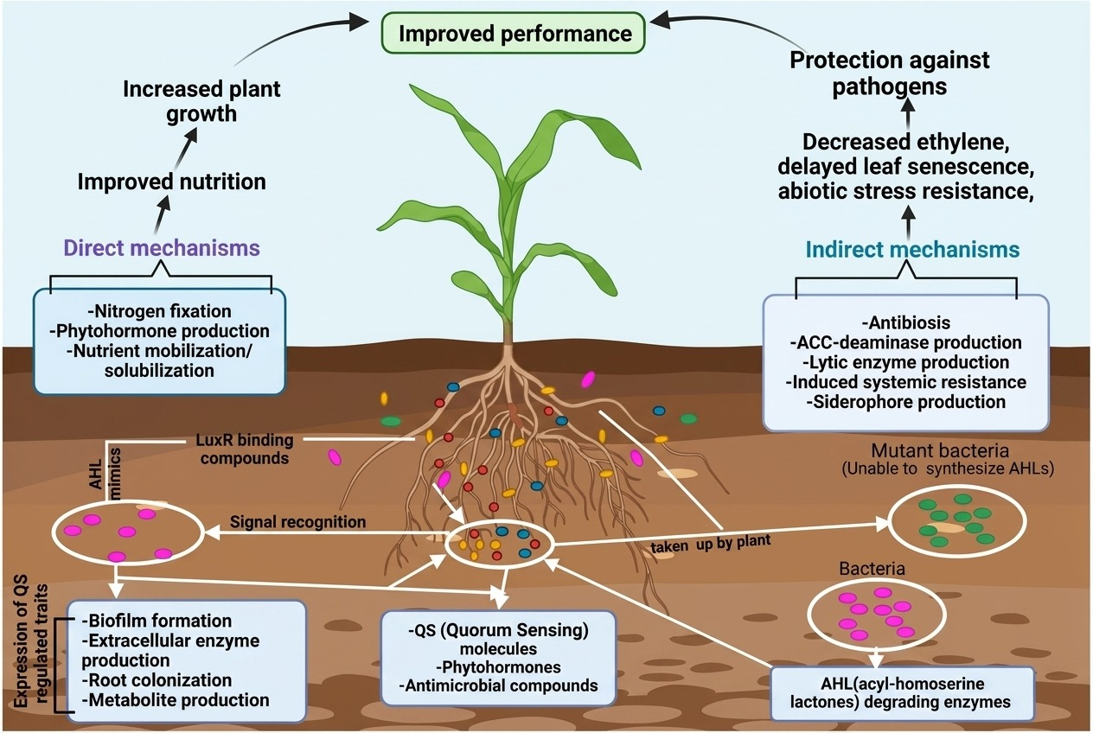


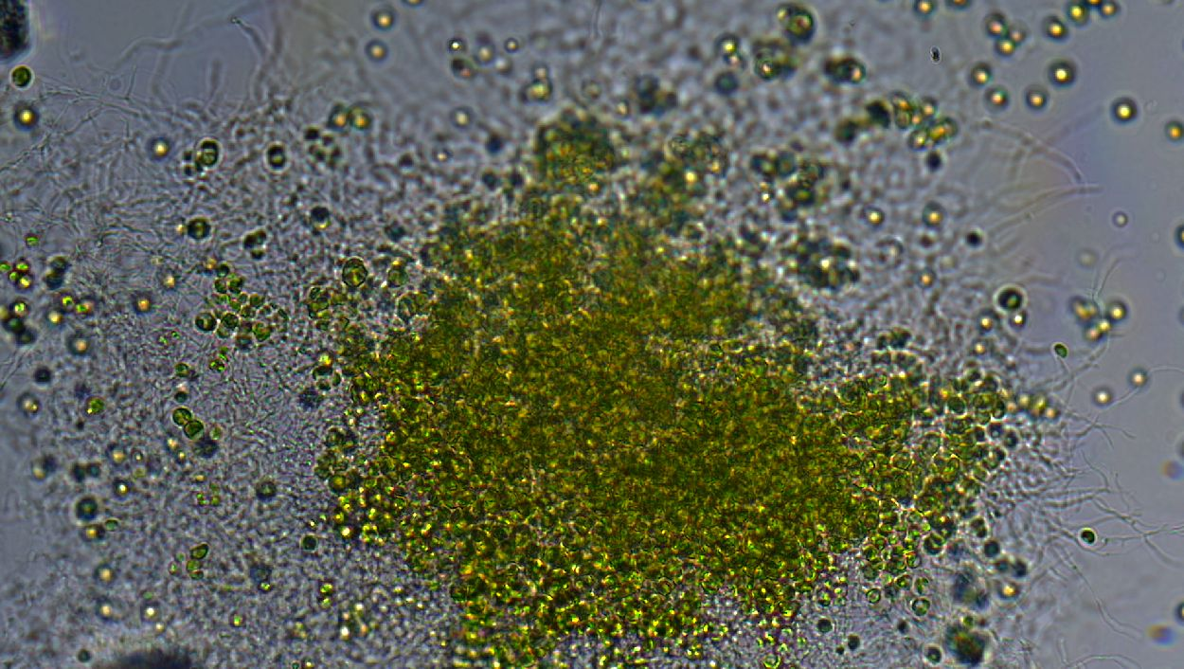
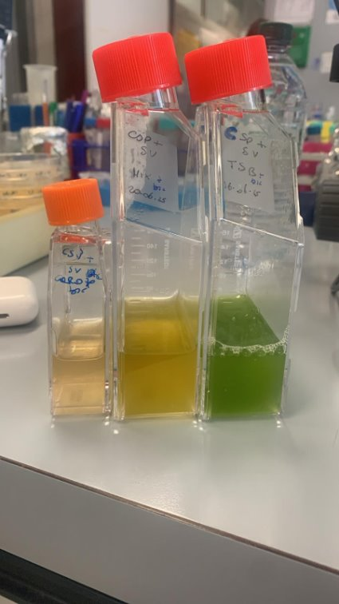
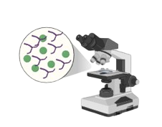
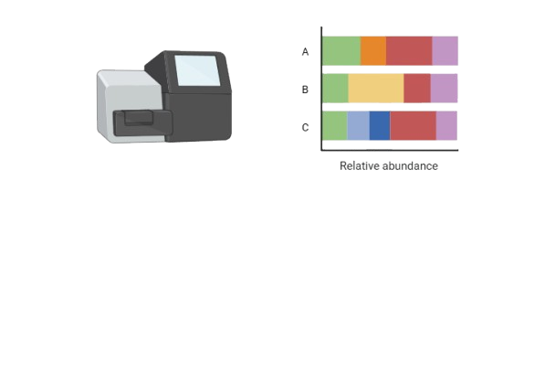
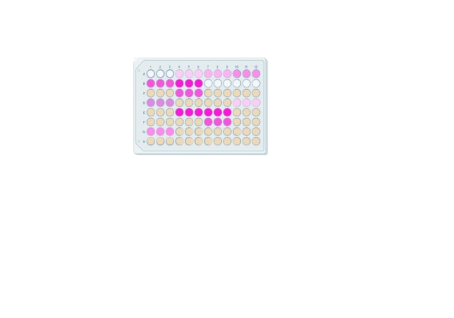
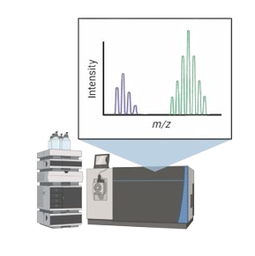
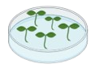
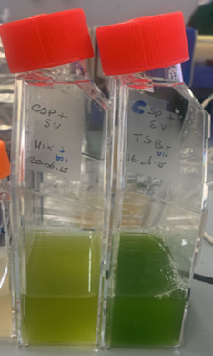
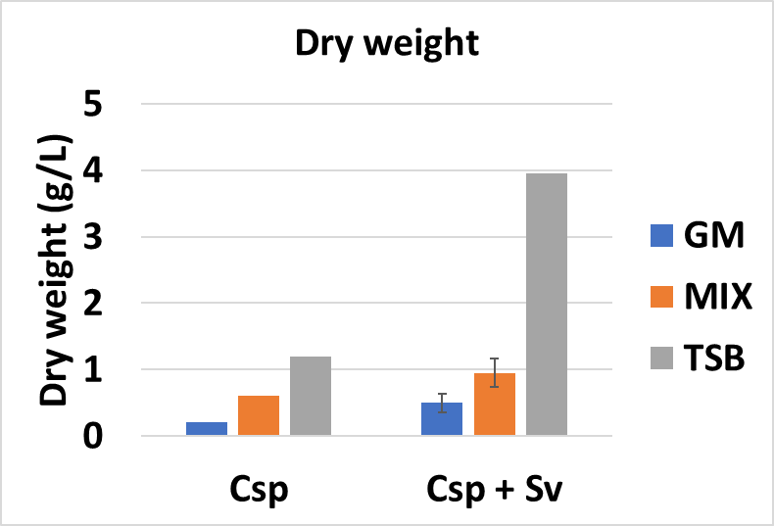
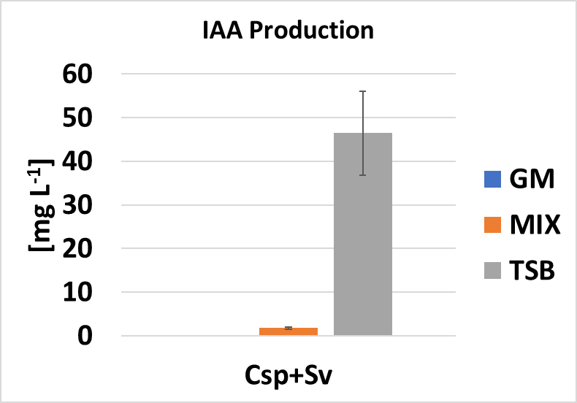
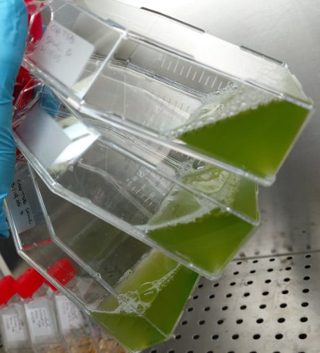
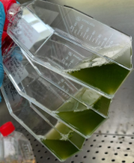
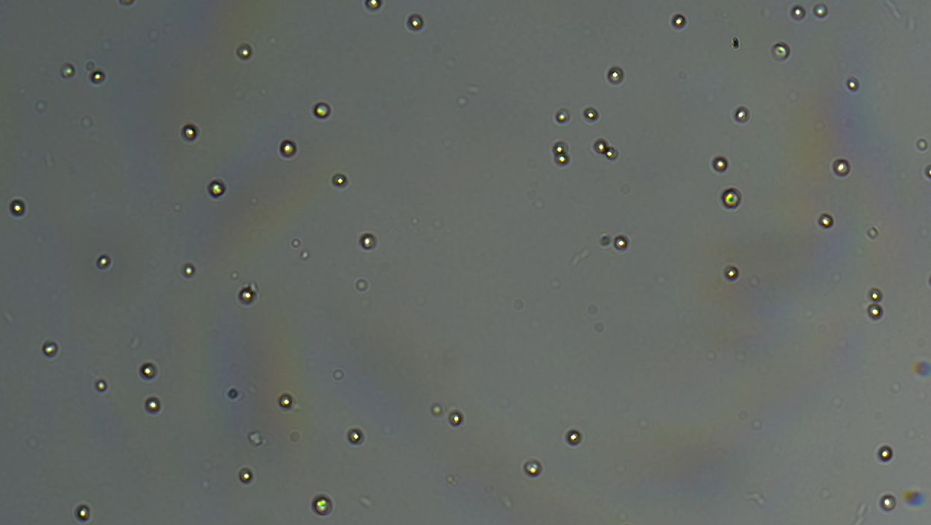
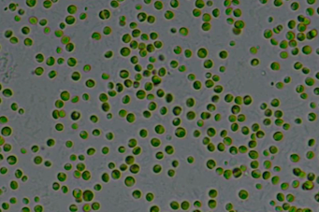
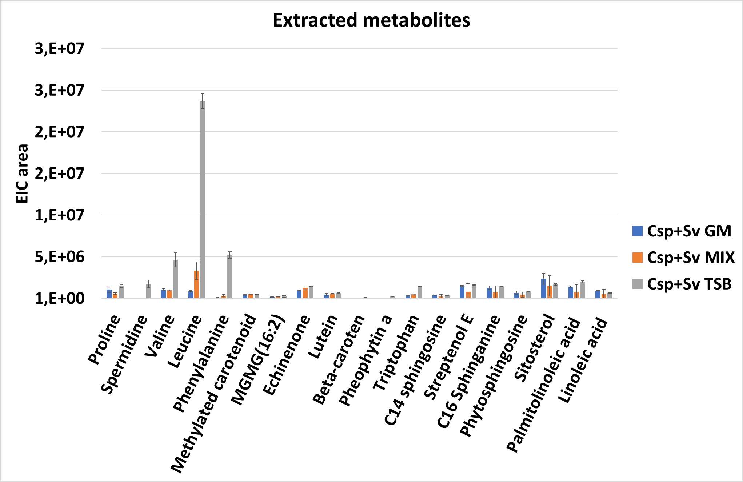
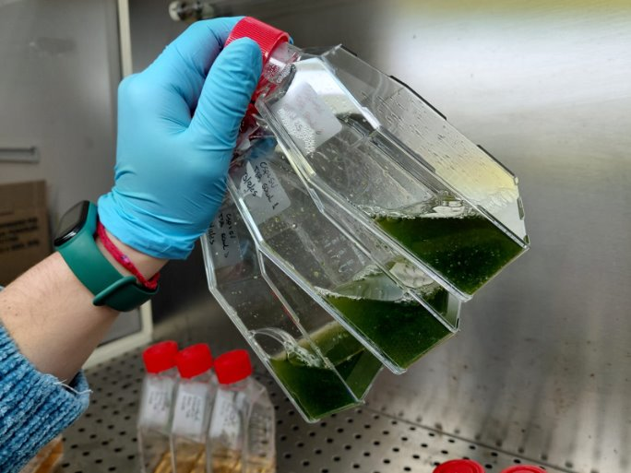
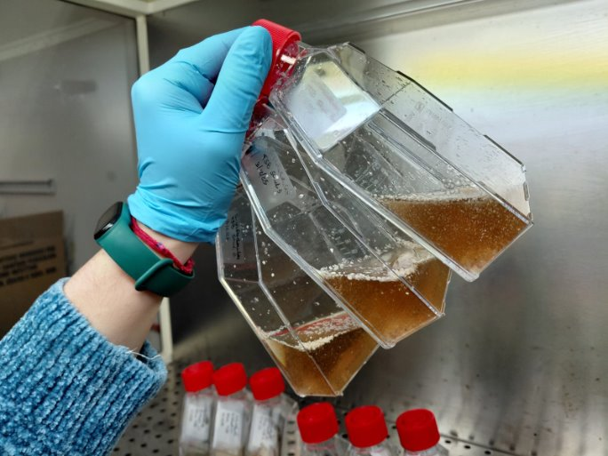
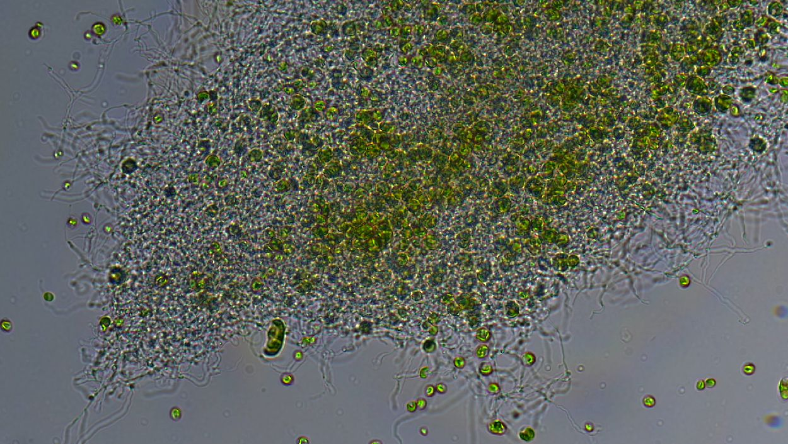
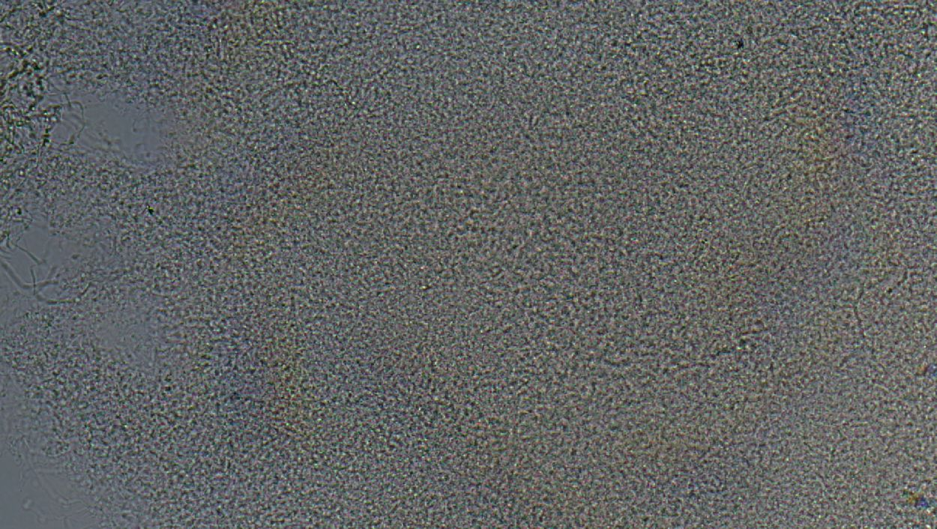
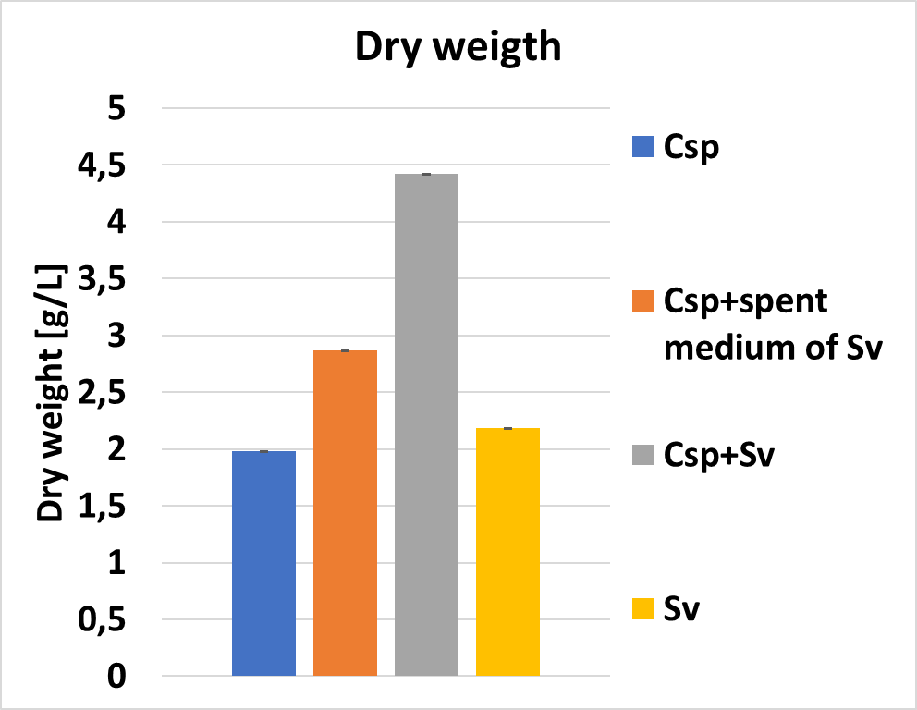
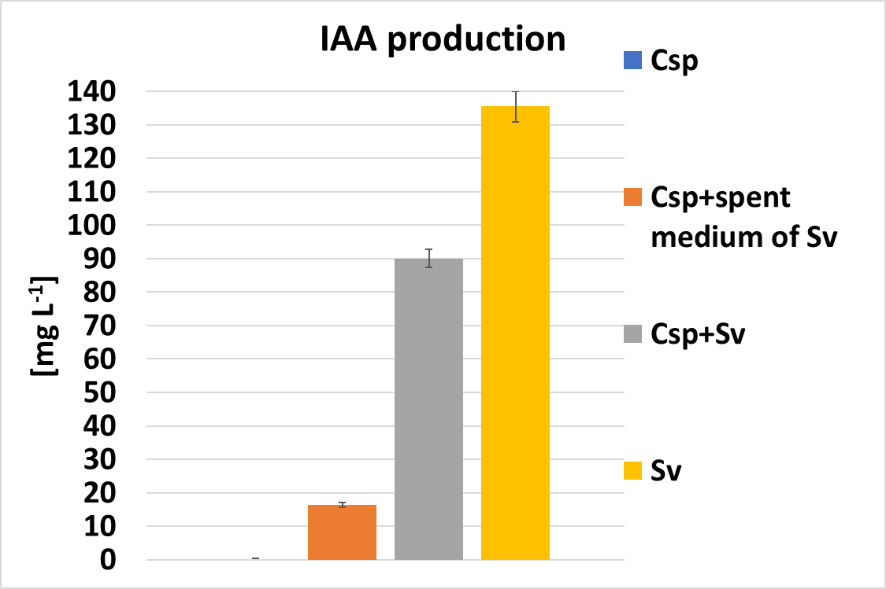
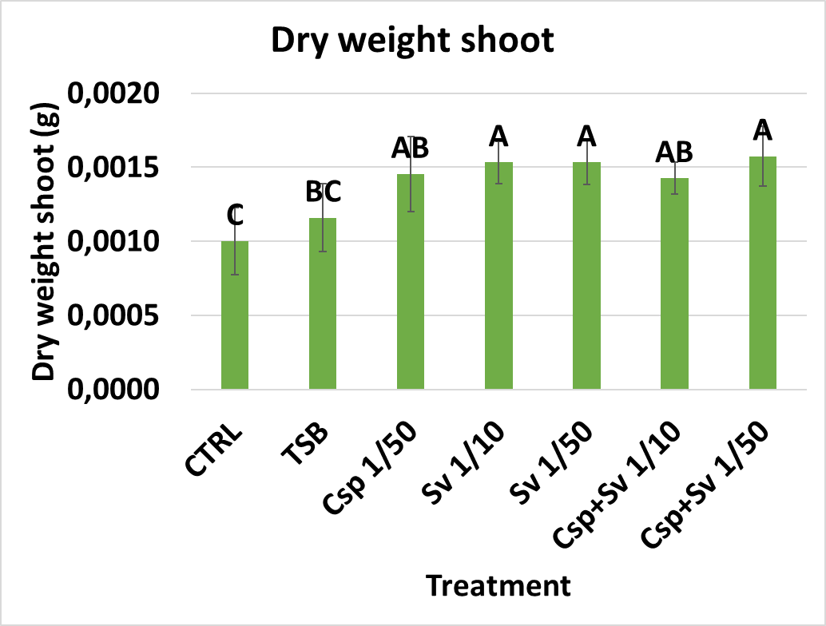
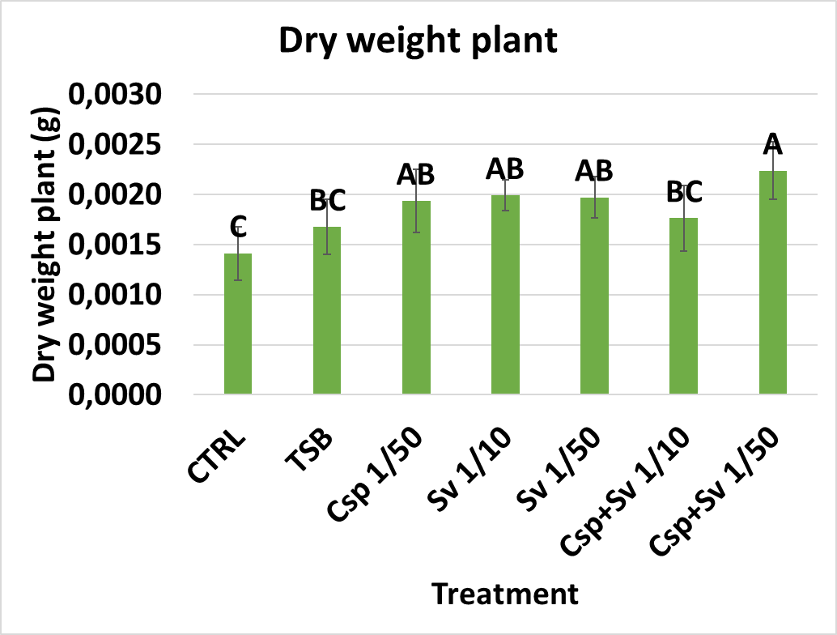





Exploring microalga and streptomycete co-cultures as plant growth-promoting systems for sustainable agriculture
Annamaria Gallo¹, Benvenuta Sonia Cusenza¹, Ciro Caldiero², Sara Amata¹, Teresa Faddetta^{1,3}, Carla Rizzo¹, Francesco Mercati², Antonio Palumbo Piccionello¹,
Giuseppe Gallo^{1,3}, Valeria Villanova¹
¹Dipartimento STEBICEF, Università degli Studi di Palermo, Viale delle Scienze, 90128 Palermo, Italy.
²Consiglio Nazionale delle Ricerche, Institute of Biosciences and Bioresources (IBBR), Corso Calatafimi 414, 90129 Palermo, Italy
³NBFC National Biodiversity Future Center, Piazza Marina 61, 90133 Palermo, Italy
1.Introduction
The intensive use of chemical fertilizers and pesticides has caused environmental damage and increased costs, highlighting the need for sustainable alternatives. Biofertilizers, based on plant growth-promoting (PGP) microorganisms, offer an eco-friendly strategy to enhance plant performance through microbiome modulation. Streptomyces spp. are known for producing a wide range of bioactive compounds¹. Similarly, microalgae contribute to carbon fixation and to the production of valuable bioactive molecules². In this study, the co-culture of Chlorella sp. (Csp) and Streptomyces violaceoruber (Sv) was evaluated for its PGP potential.
2.Key message
3.Methodology
Co-culture of Csp and Sv boosts metabolism, IAA production, and Solanum lycopersicum plant growth.
Single culture
Single culture
S. violaceoruber
Chlorella sp.
4.Results – medium selection for co-culture
Morpho-physiological characterization in different media
Co-culture
We evaluated enriched artificial seawater, (Gold Medium, GM), an 4th-range leftovers agro-industrial waste (MIX), and Tryptic Soy Broth (TSB) to monitor co-culture (Csp+Sv) growth, indole-3-acetic acid (IAA) synthesis, and metabolite production.
Metagenomics study
Evaluation of PGP traits in different media
On going…
Metabolomics characterization in different media
In vitro test on
S. lycopersicum
Cultures
C
A
B
5.Results-TSB medium deep-dive analysis
A
Cultures
B
Microscopic observations
A1
A2
B1
B2
D
A3
A4
B3
B4
Fig. 2 Cultures (A) and Microscopic observations (B) of Csp (A1, B1), of Csp+ spent medium of Sv (A2, B2), and the co-culture Csp+Sv (A3, B3) and Sv (A4, B4).
A
B
Fig. 1 Co-coltures of Csp+Sv in MIX and TSB (A), dry weight (B), indole-3-acetic acid (IAA) production (C), and quantitative profiles of methanol-extracted metabolites in EIC area (D) of Csp and Csp+Sv grown in different media: GM, MIX, and TSB.
Fig. 3 Dry weight (A) and Indole-3-acetic acid (IAA) production (B) of Csp grown in TSB medium under different conditions: Csp, Csp+Sv spent medium, Csp+Sv and Sv.
6.Conclusion
A
B
Co-culture of Csp and Sv boosts metabolism, IAA production, and S. lycopersicum plant growth.
TSB optimized biomass and biostimulant traits compared to GM and agro-industrial waste MIX.
Future works will focus on scale-up cultivation to 5L bioreactors, test concentrated MIX medium to lower process costs and perform omics analysis to resolve symbiotic pathways.
7.Acknowledgments
Fig. 4 Dry weight shoot (A) and Dry weight plant (Shoot+Root B) in S. lycopersicum exposed to different treatments compared to control (CTRL). Different letters indicate means that differ significantly, according to Tukey’s HSD test at p < 0.05.
This research has been financially supported by the European Commission – NextGenerationEU, Project SUS-MIRRI.IT «Strengthening the MIRRI Italian Research Infrastructure for Sustainable Bioscence and Bioeconomy», code n. IR0000005PO. This research was supported by European Commission – NextGenerationEU, Piano Nazionale Resistenza e Resilienza (PNRR) – Missione 4 Componente 2 Investimento 1.4 – Avviso n. 3138 del 16 dicembre 2021 rettificato con D.D. n. 3175 del 18 dicembre 2021 del Ministero dell’Università e della Ricerca – CN5 «National Biodiversity Future Center» – NBFC – code n. CN00000033 from the National Recovery and Resilience Plan (NRRP), under Grant/Award Number: MSCA_0000011. The authors acknowledge the third-party research project ROW2Bios (CON-0671), funded by O.P. Agrinsieme (Latina, Italy). Research carried out within the Project "FILIERA INTEGRATA FRUTTA ESOTICA ITALIANA MAZZONI" founded by the Ministero dell’Agricoltura, della Sovranità Alimentare e delle Foreste (MASAF), announcement prot. no. 182458 of 04/22/2022, PROJECT CODE/beneficiary CUP, CFDA50247067 / J77G21000020001
8.References
1. Faddetta T et al. Bioactive Metabolite Survey of Actinobacteria Showing Plant Growth Promoting Traits to Develop Novel Biofertilizers. Metabolites. 2023 Mar 2;13(3):374. doi: 10.3390/metabo13030374. PMID: 36984814; PMCID: PMC10052678.
2. Licata G. et al. Mixotrophy in Marine Microalgae to Enhance Their Bioactivity. Microorganisms. 2025 Feb 5;13(2):338. doi: 10.3390/microorganisms13020338. PMID: 40005705; PMCID: PMC11858253.
Cortona Prokaryotes 2026
Cortona, 17-19 Giugno 2026

