Slide 1






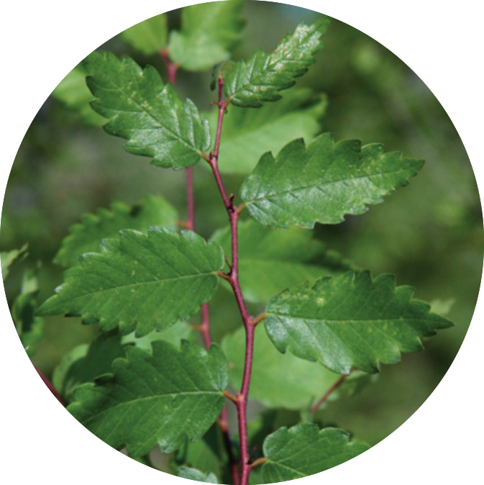
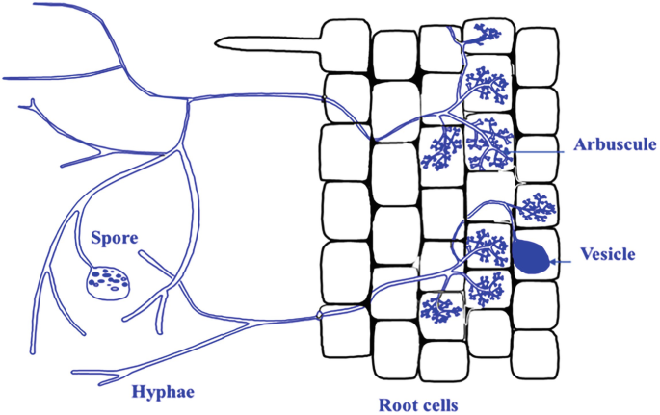
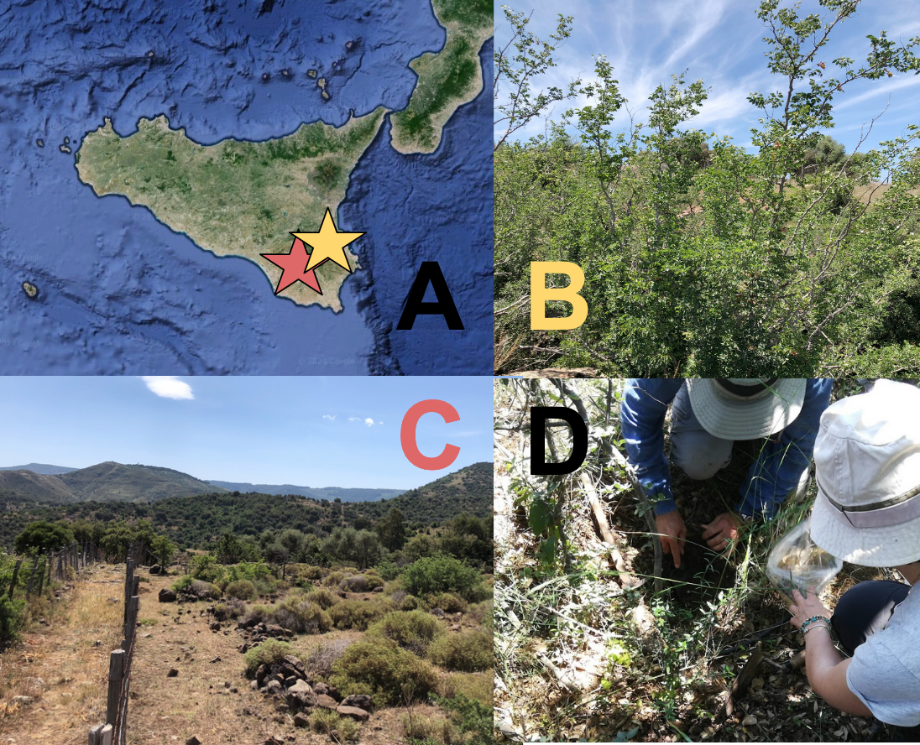
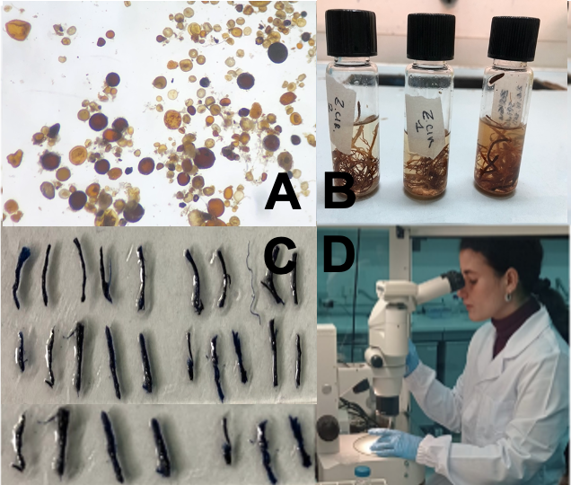
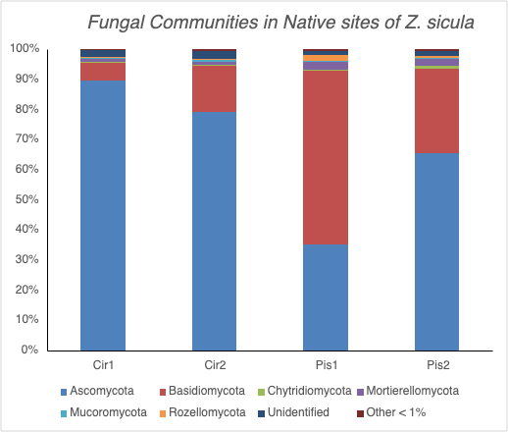
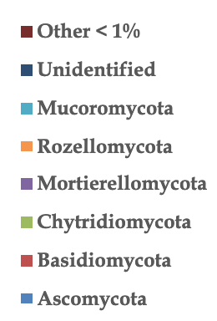
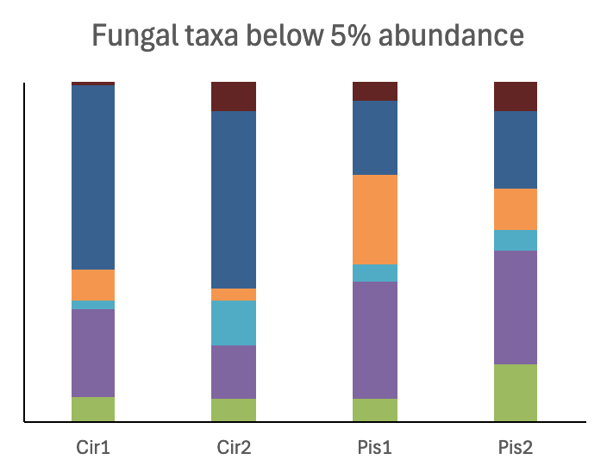
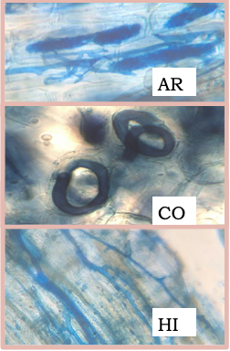
First report of mycorrhizal colonization of Zelkova sicula
(Di Pasquale, Garfi & Quézel, 1992) an endemic relict tree of Cenozoic Flora
Giulia Cosimi¹, Silvia La Scala¹, Giuseppe Garfì², Marcello Tagliavia^{1,3}, Silvia Marsili⁴, Daniela Cataldo⁴, Carmen Impelluso⁴, Giancarlo Perrotta⁴, Paola Quatrini¹
1 - Dpt. of Biological, Chemical and Pharmaceutical Sciences and Technologies, STEBICEF, University of Palermo, Viale delle Scienze bldg 16 (PA), Italy
2 - Institute of Biosciences and BioResources, IBBR, National Research Council, Via Ugo la Malfa, 153, I-90146 Palermo (PA), Italy
3 - Institute for Biomedical Research and Innovation, National Research Council, IRIB-CNR, Via Ugo La Malfa 153 90146, Palermo (PA), Italy
4 - Dpt. dello sviluppo rurale e territoriale, Regione Siciliana, Via S. Giovanni alle Catacombe n. 7 - 96100 - Siracusa (SR), Italy
Zelkova sicula (Ulmacee),
is an Endemic climate relict found in Sicily, Italy
Critically Endangered in the IUCN Red List
and among the "Top 50 Mediterranean
Island Plants" at the brink of extinction
Z. sicula can’t reproduce sexually!
Other threats: extremely small size of the known populations, loss of genetic variability, inadequate adaptation to the current habitat, significant human disturbance¹
Arbuscular Mycorrhizal Fungi (AMF)
Glomeromycota
They form mutualistic symbioses with 80% of plants
Increase host performances and resistance to biotic and abiotic stressors³
Are obligate symbionts with reduced specialization toward host⁴
High potential in conservation!⁵
Introduction
Fig.1 - Zelkova sicula stem
Fig. 2 - Diagram of the arbuscular endomycorrhizal structure,
Meng, L. et al. (2023)²
              Verify the endomycorrhizal symbiosis in Zelkova sicula and its colonization status
  Test AMF as biostimulants in propagational processes of rare and recalcitrant plants
AIM
SOIL CHARACTERISTICS | ZS1 | ZS2
pH | 6.6 ± 0.06 | 7.4 ± 0.04
Total Organic Carbon (TOC) g/kg | 70.5 ± 14 | 26.5 ± 2.7
Organic Matter (OM) g/kg | 121.5 ± 24.1 | 45.8 ± 4.7
Microbial Biomass (MB) μg DNA / gr soil d.w. | 14.33 | 21.16
Assimilable P mg/kg | < 4 | < 4
Total N g/kg | 8.05 ± 1.9 | 2.3 ± 0.2
Electrical Conductivity mS/cm | 0.20 ± 0.02 | 0.15 ± 0.004
Cation exchange capacity (CEC) meq/100g | 33.23 ± 4.4 | 31.2 ± 1.6
Material & Methods
Fig. 3 - Z. sicula geographical locations (A), native sites (B,C) and sampling activity (D).
Fig. 4 - Spores extracted by wet sieving(A), decoloring (B) and roots trypan-blue staining (C), Scoring (D).
Tab.1 - Chemical-physical soil properties of native sites.
MYCORRHIZAL STATUS |  | ZS1 Pisano | ZS2 Ciranna
Spore density | sp. number / 100 g soil d.w. | 768 | 3279
Spore Morphotype | n° | 12 | 17
Roots Colonization % | F % | 43.3 | 97.5
 | M % | 3.2 | 48.9
 | A% | 0.7 | 24.4
Arum- or Paris- type | - | Intermediate | Intermediate
Soil fungal diversity in native sites of Z. sicula
Results
Fungal taxa below 5% abundance
6%
5%
4%
3%
2%
1%
ZS2a ZS2b ZS1a ZS1b
ZS2a ZS2b ZS1a ZS1b
Tab. 2 - Z. sicula populations and their mycorrhizal status. Zelkova sicula mycorrhizal colonization range between 43% and 98%.
Fig. 5 - Metabarcoding of rhizosphere soil fungal communities at native sites ZS1 (ZS1a and ZS1b) sites and ZS2 (ZS2a and ZS2b). In ZS1 Basidiomycota are much more abundant than in ZS2. Glomeromycota are included in “Other <1%” but they were more abundant in ZS2.
MOLECULAR IDENTIFICATION OF AMF SPORES FROM ZS2 NATIVE SOIL
AMF taxa | Samples | Relative Abundance range (%)
Entrophospora etunicata | Native soil, Sorghum trap-colture | 13 - 50
Funneliformis geosporum* | Native soil | 5
Paraglomus sp. | Native soil | 0.4 - 4.9
Archeospora sp. | Native soil, Sorghum trap-colture | 0.1 - 4
Ambispora sp. | Native soil | 2.10
First report of mycorrhizal status of Zelkova sicula.
AMF spore density: inversely correlated to soil organic matter and positively to pH⁸.
Metabarcoding analysis shows larger abundance of Basidiomycota in ZS1 soil. Glomeromycota OTUs (“other <1%” in the graphs) are more abundant in ZS2 soil.
ZS2 soil shows higher density of AMF spores and its population has higher values of mycorrhizal colonization.
Most abundant AMF taxa belong to ubiquitous genera, but Paraglomus is more susceptible to geographical and soil variations, hence possibly endemic.
Experiments are underway to use native AMFs as biostimulants on Z. sicula micro-cuttings and cuttings for conservation purposes!
Results
Conclusions
* Detected also in Z. sicula roots
Tab. 3 - Molecular identification by amplification and sequencing of AMF spores DNA from Native Soil and/or from Trap Colture (Sorghum) soil; we used a nested PCR with primers NS31-AM1⁶ and AML1-AML2⁷.
Fig. 6 - Endo-
mycorrhizae structures:
Arbuscules (AR),Coils (CO),Hyphae (HI).
Acknowledgements: This project was funded by PSR Sicilia 2014-2020, Studio, implementazione e conservazione della popolazione di Zelkova sicula, Sostegno per la salvaguardia e la valorizzazione delle risorse genetiche forestali.
References: 1) Garfì, G. et al., 2011, Flora-Morp., Distr. Funct. Eco. of Plants, 206(5), 407-417; 2) Meng, L. et al. 2023, Innovation for Environmentally-friendly Food Prod. and Food Safety in China, 139-180; 3) Jeffries, P. et al., 2003, Biol Fertil Soils 37: 1-16.; 4) Chen, M. et al. , 2018, Front Plant Sci, 9:1270; 5) Bothe, H. et al., 2010, Myco 20: 445-457; 6) Helgason, T. et al., 1998, Nature, 394.6692: 431-431.; 67 Lee, J. et al., 2008, FEMS Microbio Eco, Vol. 65, 2, 339–349; 8) Tedersoo L. et al., 2014, Science, 346,1256688.

