Slide 1
Non-equilibrium thermodynamics of gravitational objective-collapse models
Talk for "Fundamental Problems in Quantum Physics 2025”,
By Simone Artini, in collaboration with G. Lo Monaco , S. Donadi and M. Paternostro.

Slide 2

It’s good to be back…

Slide 3
Outlook of the talk
Collapse models: general structure, the heating problem, dissipative generalization;
Entropy production;
Thermodynamics of the DP model and its generalization.
(based on: https://arxiv.org/abs/2502.03173)

Slide 4
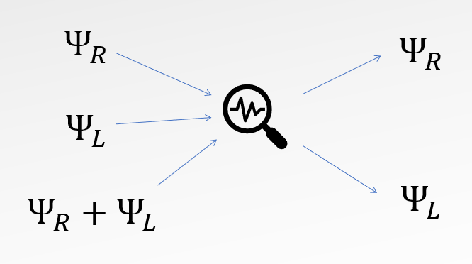
COLLAPSE MODELS
Two axioms for two different dynamics:
The Schrödinger equation
(linear and deterministic)
Wave-function collapse + the Born rule
(non-linear and stochastic)

Slide 5
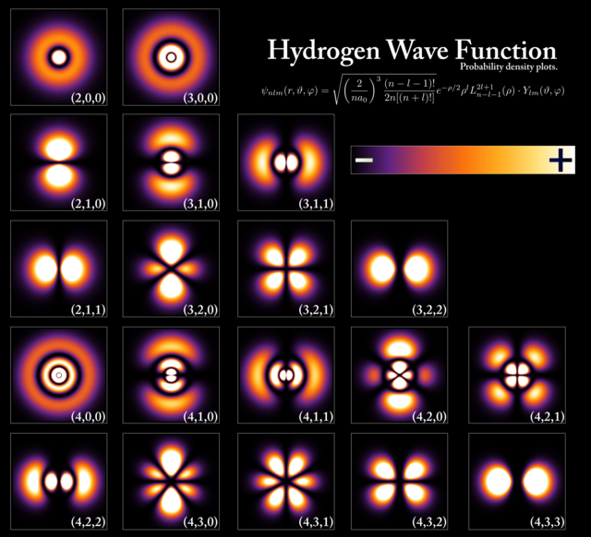
COLLAPSE MODELS
We need the measurement procedure to glue these two descriptions together… and it works very well!
But how do we connect the quantum world with the classical world? What exactly is a measurement?
There are many proposals to explain the quantum-to-classical-transition.

Slide 6
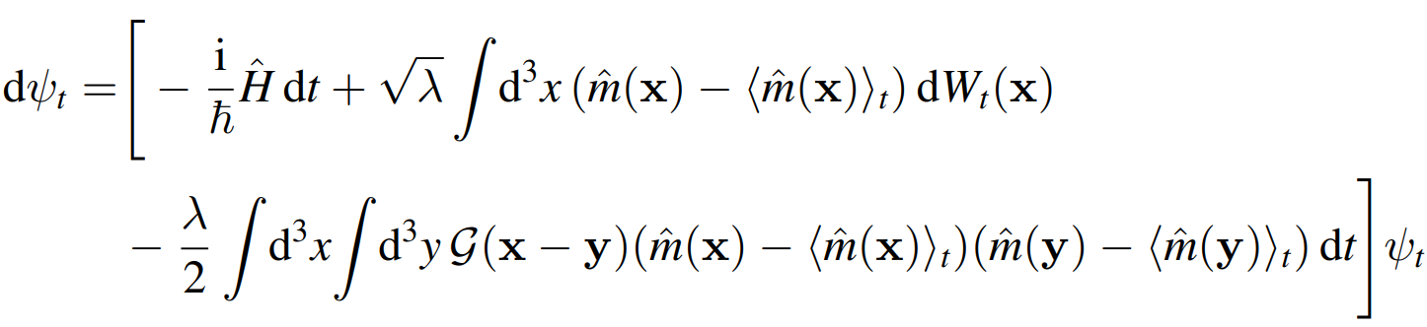
COLLAPSE MODELS
Unified dynamcs approach: modified Schrödinger equation with an additional stochastic and non-linear term.

Slide 7
COLLAPSE MODELS
Unified dynamcs approach: modified Schrödinger equation with an additional stochastic and non-linear term.
General structure
Defines the particular collapse model

Slide 8
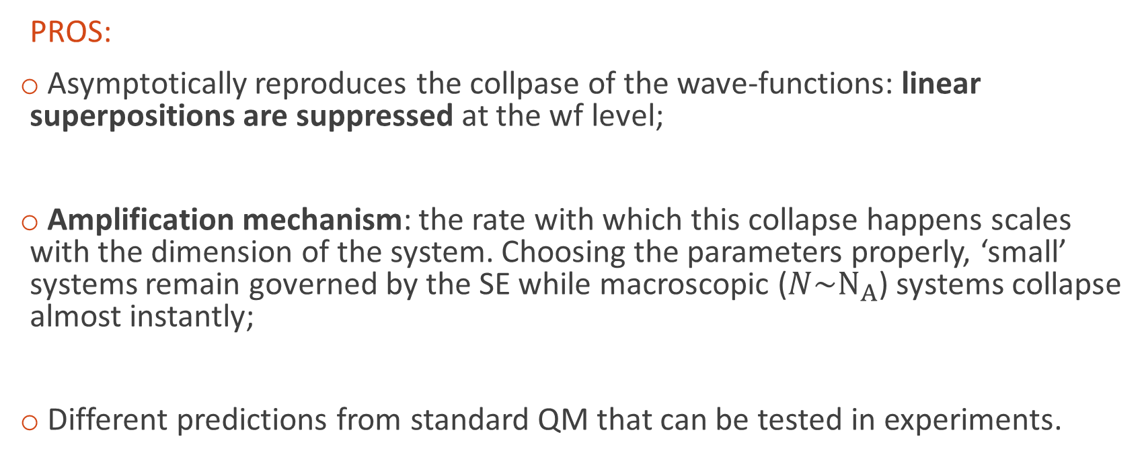
COLLAPSE MODELS
PROS:
Asymptotically reproduces the collpase of the wave-functions: linear superpositions are suppressed at the wf level;
Amplification mechanism: the rate with which this collapse happens scales with the dimension of the system. Choosing the parameters properly, ‘small’ systems remain governed by the SE while macroscopic ($N\sim N_{A}$) systems collapse almost instantly;
Different predictions from standard QM that can be tested in experiments.

Slide 9

COLLAPSE MODELS
CONS:
Unbounded heating: $<\hat{H}> = <\hat{H}>_{Sch}+ P⋅t$
Can I distinguish the spontaneous collapse from other forms of decoherence?

Slide 10
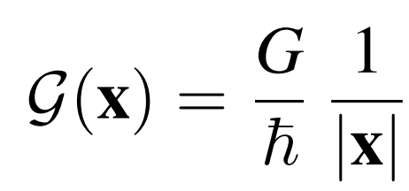
THE DIóSI-PENROSE MODEL
Penrose proposes to ‘gravitize’ quantum mechanics: linear superpositions are ‘excitations’ of space-time that decay with a certain rate proportional to the mass.
Diósi proposes a collapse model with a Newtonian potential as the spatial correlation function:
The two models predict the same time scale for the life time of the superpositions.

Slide 11
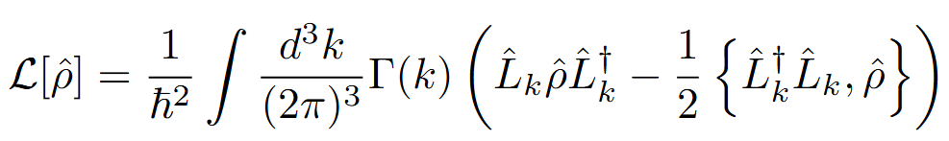
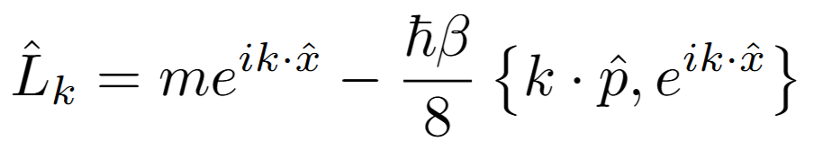
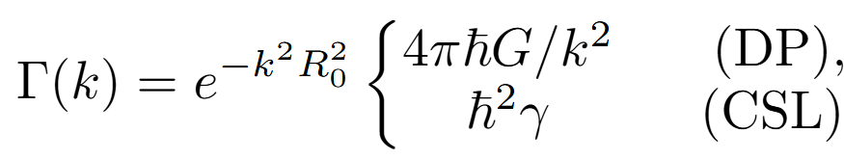

DP MODEL WITH LINEAR FRICTION
We will consider a dissipative extension proposed in Di Bartolomeo, G., Carlesso, M., Piscicchia, K., Curceanu, C., Derakhshani, M., & Diósi, L. (2023). Physical Review A, 108(1), 012202:
with:
Which allows for a relaxation to a finite energy: $<E{> }_{∞}=\frac{ P}{Γ}$.

Slide 12
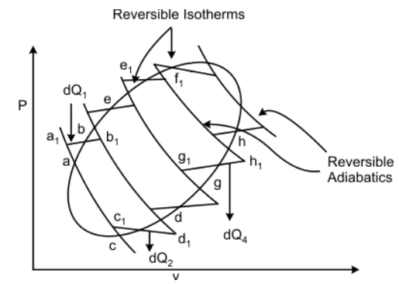

THERMODYNAMICS
Quasi-static transformation
↔
Equilibrium at each time step
Reversibility
$$ΔS=0$$
https://home.iitk.ac.in/~gtm/thermodynamics/lecture21/21_3.htm

Slide 13
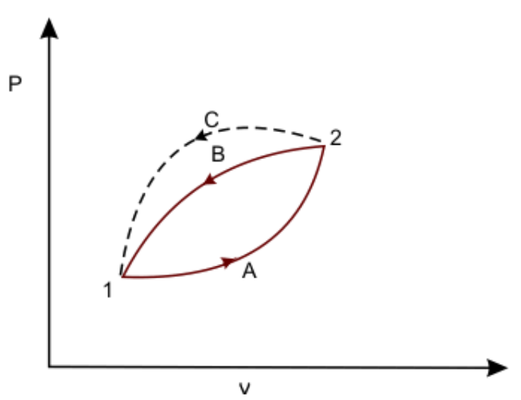
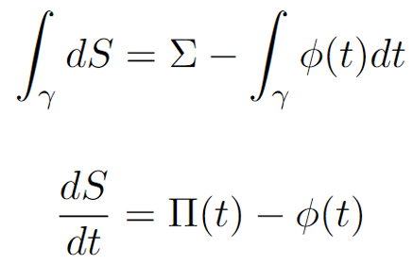
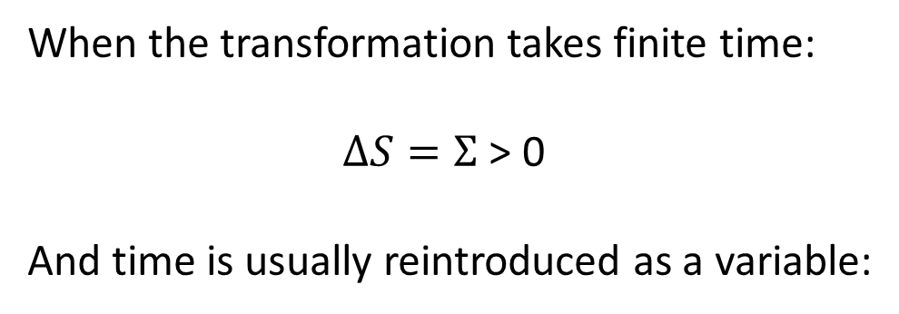
THERMODYNAMICS
When the transformation takes finite time:
$ΔS=Σ$ > 0
And time is usually reintroduced as a variable:
https://home.iitk.ac.in/~gtm/thermodynamics/lecture23/23_2.htm

Slide 14
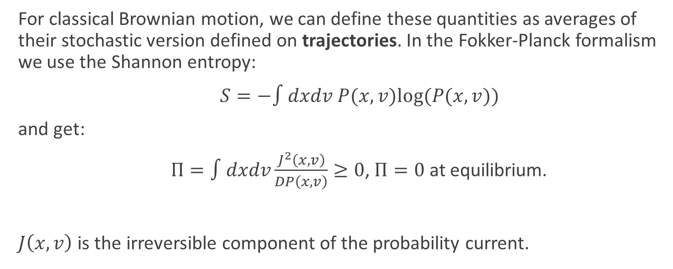
STOCHASTIC THERMODYNAMICS
For classical Brownian motion, we can define these quantities as averages of their stochastic version defined on trajectories. In the Fokker-Planck formalism we use the Shannon entropy:
$S=−∫dxdv P(x,v)log(P(x,v))$
and get:
$Π=∫dxdv\frac{J^{2}\left(x,v\right)}{DP\left(x,v\right)}≥0$, $Π=0$ at equilibrium.
$J\left(x,v\right)$ is the irreversible component of the probability current.

Slide 15
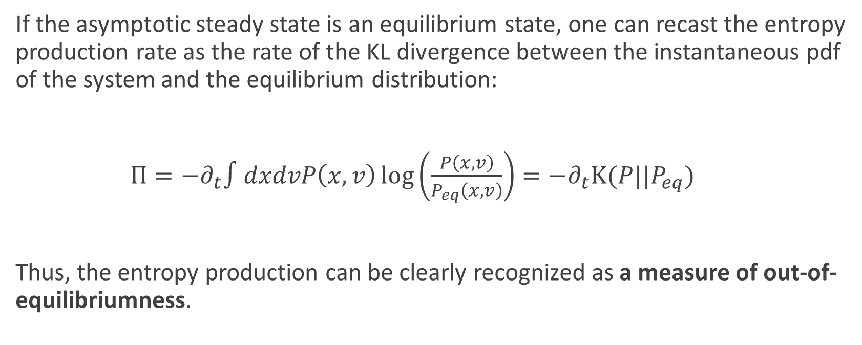
STOCHASTIC THERMODYNAMICS
If the asymptotic steady state is an equilibrium state, one can recast the entropy production rate as the rate of the KL divergence between the instantaneous pdf of the system and the equilibrium distribution:
$Π=−∂_{t}∫dxdvP\left(x,v\right)\log\left(\frac{P\left(x,v\right)}{P_{eq}\left(x,v\right)}\right)=−∂_{t}K(P||P_{eq})$
Thus, the entropy production can be clearly recognized as a measure of out-of-equilibriumness.

Slide 16
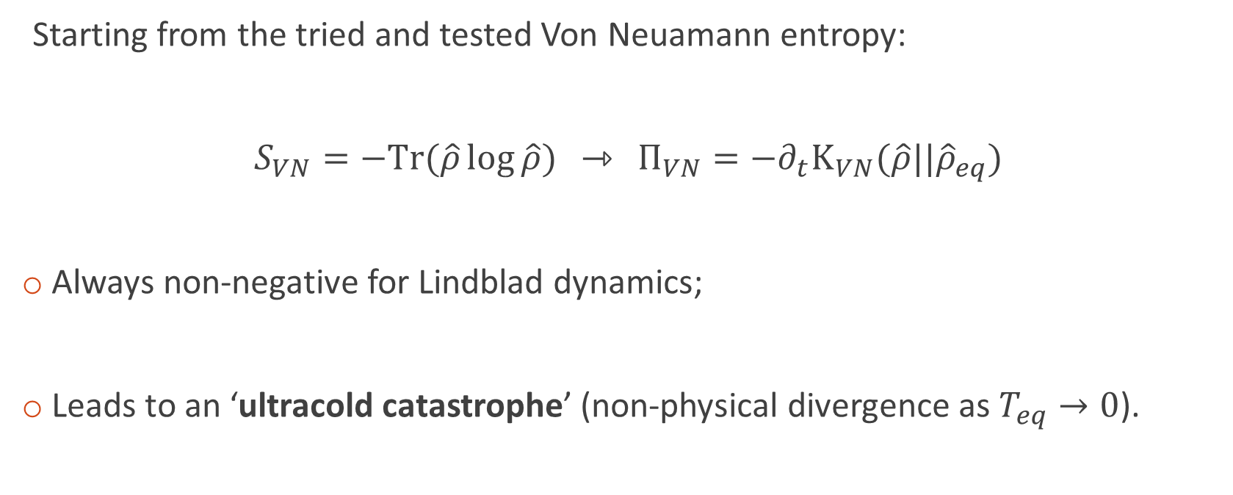
QUANTUM ENTROPIES
Starting from the tried and tested Von Neuamann entropy:
$S_{VN}=−Tr(\hat{ρ}\log{\hat{ρ}})$ ⇾ $Π_{VN}=−∂_{t}K_{VN}(\hat{ρ}||{\hat{ρ}}_{eq})$
Always non-negative for Lindblad dynamics;
Leads to an ‘ultracold catastrophe’ (non-physical divergence as $T_{eq}→0$).

Slide 17
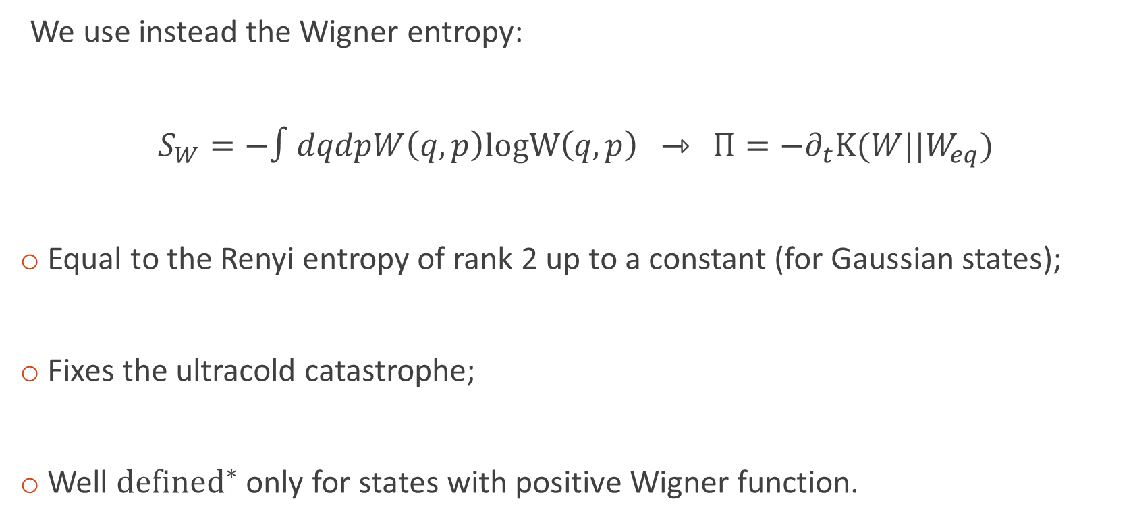
QUANTUM ENTROPIES
We use instead the Wigner entropy:
$S_{W}=−∫dqdpW\left(q,p\right)logW\left(q,p\right)$ ⇾ $Π=−∂_{t}K(W||W_{eq})$
Equal to the Renyi entropy of rank 2 up to a constant (for Gaussian states);
Fixes the ultracold catastrophe;
Well $defined^{∗}$ only for states with positive Wigner function.

Slide 18
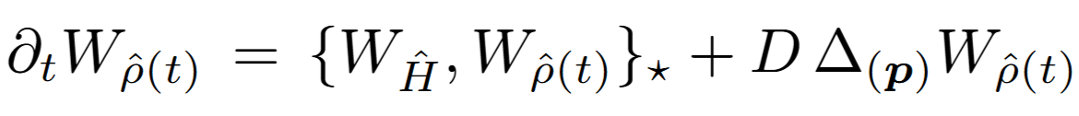
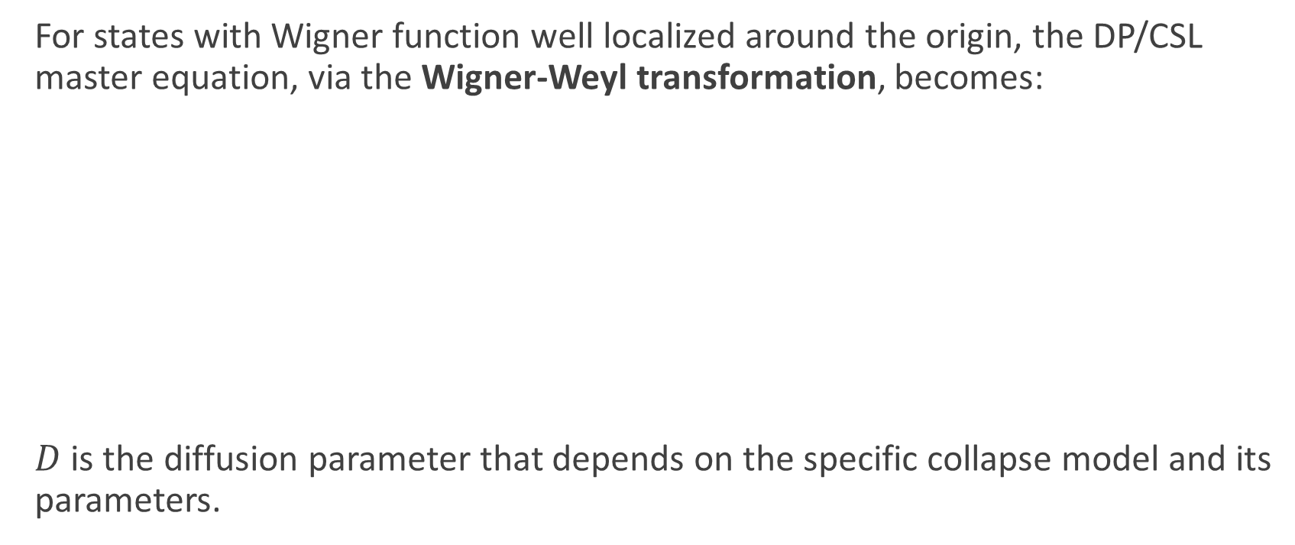
COLLAPSE DYNAMICS IN PHASE-SPACE
For states with Wigner function well localized around the origin, the DP/CSL master equation, via the Wigner-Weyl transformation, becomes:
$D$ is the diffusion parameter that depends on the specific collapse model and its parameters.
Unitary part of the dynamics
(Moyal brackets)
Diffusion in momentum

Slide 19
COLLAPSE DYNAMICS IN PHASE-SPACE
For states with Wigner function well localized around the origin, the DP/CSL master equation, via the Wigner-Weyl transformation, becomes:
For potentials at most quadratic in position and momentum (Moyal br. = Poisson br.) this is Brownian motion without friction!

Slide 20
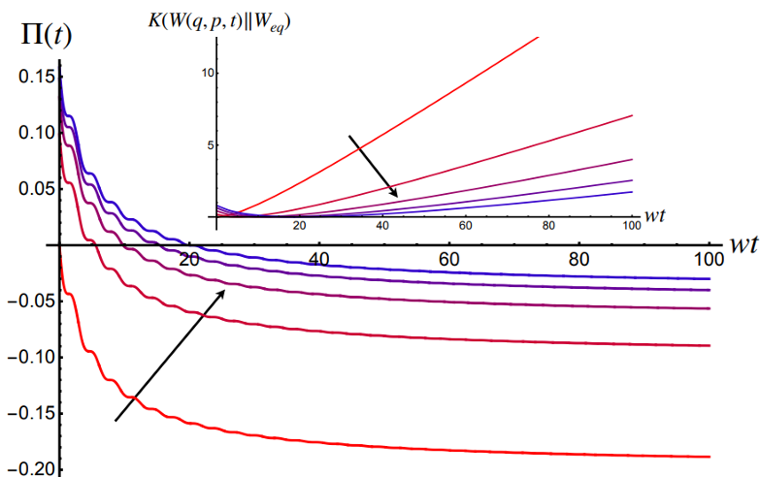
COLLAPSE DYNAMICS IN PHASE-SPACE
INFINITE TEMPERATURE NOISE FIELD, NO ASYMPTOTIC EQUILIBRIUM.

Slide 21
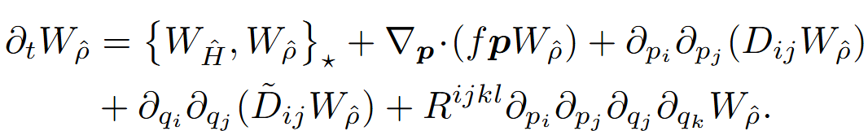
LINEAR FRICTION DP MODEL
Considering instead the dissipative extension of the DP model introduced earlier, we get the following pde describing the evolution of the Wigner function (again, for well concentrated Wigner functions):
Non-gaussian terms appear from the collapse terms even in this approximation, making it very difficult to treat.

Slide 22
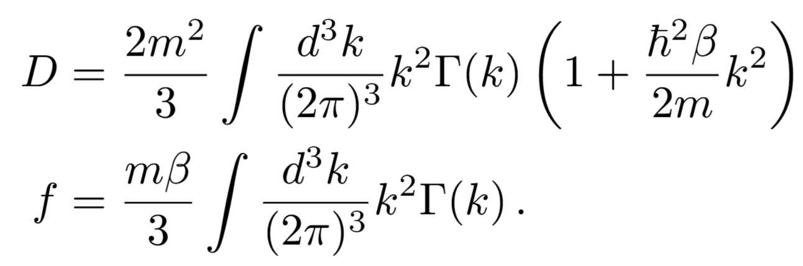


SMALL $β$ REGIME
The expression greatly simplifies considering terms at most linear in $β$ (low friction regime):

Slide 23
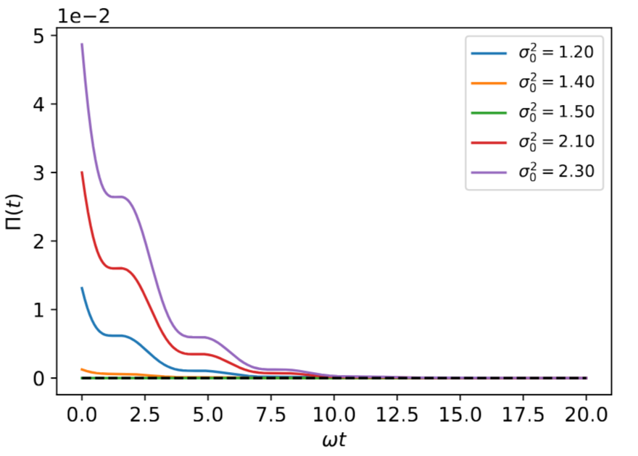
SMALL $β$ REGIME
This expression has the same functional form of the Fokker-Planck equation in phase-space of a Brownian particle (Klein-Kramers eq.), thus admitting a stationary solution.
Consequently, the entropy production rate ream remains positive throughout the dynamics amd and goes to zero asymptotically.
The system reaches thermal equilibrium.

Slide 24
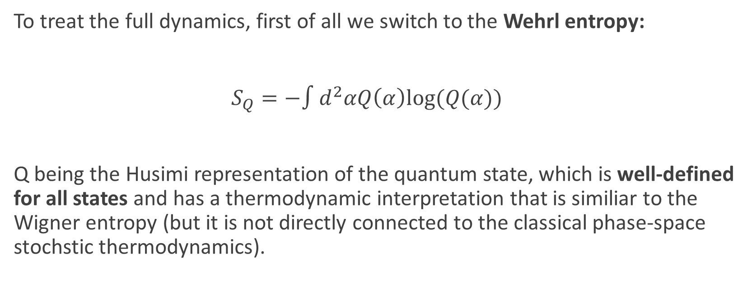
EARLY TIMES LINEARIZATION
To treat the full dynamics, first of all we switch to the Wehrl entropy:
$S_{Q}=−∫d^{2}αQ\left(α\right)log⁡(Q(α))$
Q being the Husimi representation of the quantum state, which is well-defined for all states and has a thermodynamic interpretation that is similiar to the Wigner entropy (but it is not directly connected to the classical phase-space stochstic thermodynamics).

Slide 25
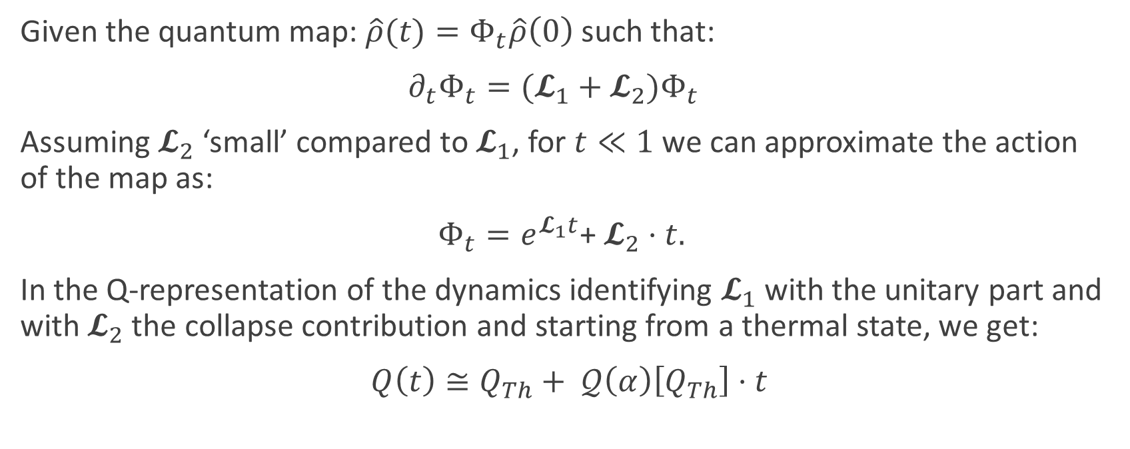
EARLY TIMES LINEARIZATION
Given the quantum map: $\hat{ρ}(t)=Φ_{t}\hat{ρ}\left(0\right)$ such that:
$∂_{t}Φ_{t}=(𝓛_{1}+𝓛_{2})Φ_{t}$
Assuming $𝓛_{2}$ ‘small’ compared to $𝓛_{1}$, for $t≪1$ we can approximate the action of the map as:
$Φ_{t}=e^{𝓛_{1}t}$+ $𝓛_{2}⋅t.$
In the Q-representation of the dynamics identifying $𝓛_{1}$ with the unitary part and with $𝓛_{2}$ the collapse contribution and starting from a thermal state, we get:
$Q\left(t\right)≅Q_{Th}+ 𝒬\left(α\right)\left[Q_{Th}\right]⋅t$

Slide 26
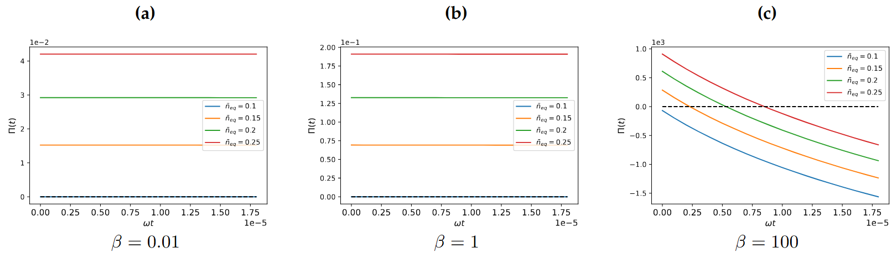

EARLY TIMES LINEARIZATION
We assume a thermal target state. Large values of $β$ seems to violate the Second law of thermodynamics:

Slide 27
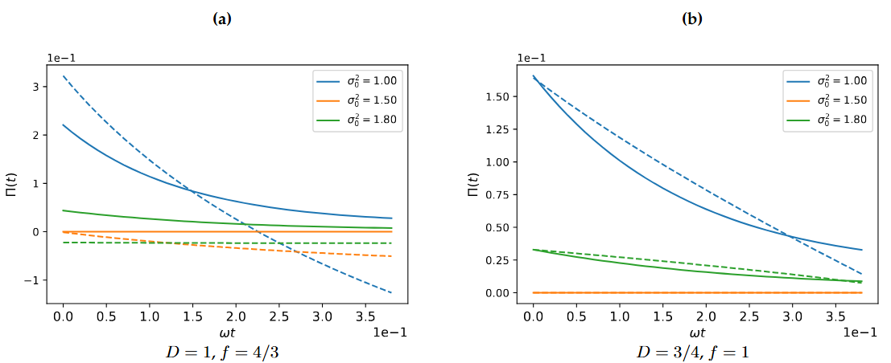
EARLY TIMES LINEARIZATION
But it could be a consequence of the linearization:

Slide 28
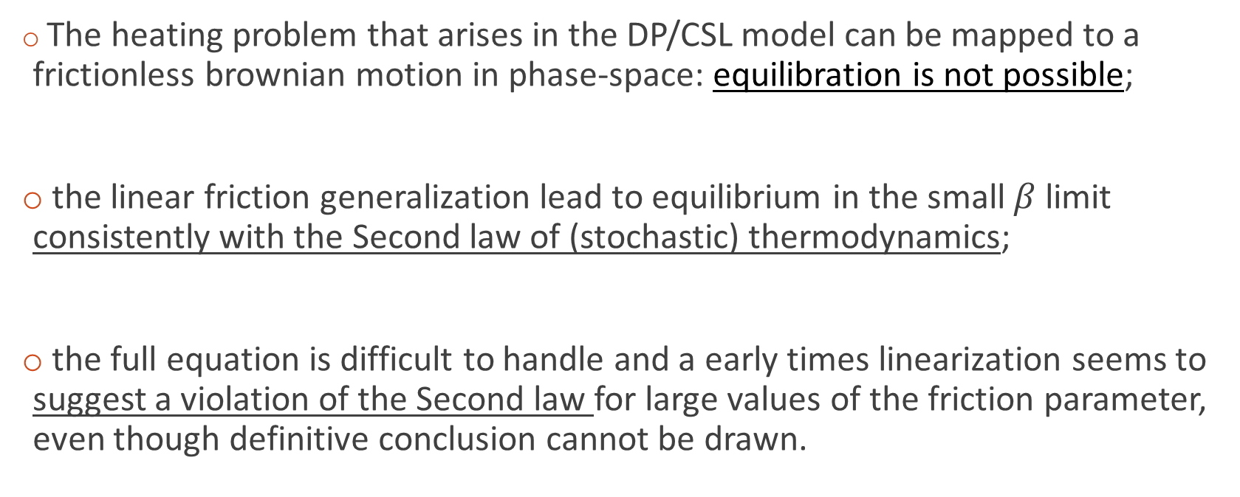
CONCLUSIONS
The heating problem that arises in the DP/CSL model can be mapped to a frictionless brownian motion in phase-space: equilibration is not possible;
the linear friction generalization lead to equilibrium in the small $β$ limit consistently with the Second law of (stochastic) thermodynamics;
the full equation is difficult to handle and a early times linearization seems to suggest a violation of the Second law for large values of the friction parameter, even though definitive conclusion cannot be drawn.

Slide 29


THANK YOU FOR THE ATTENTION!

