Slide 1




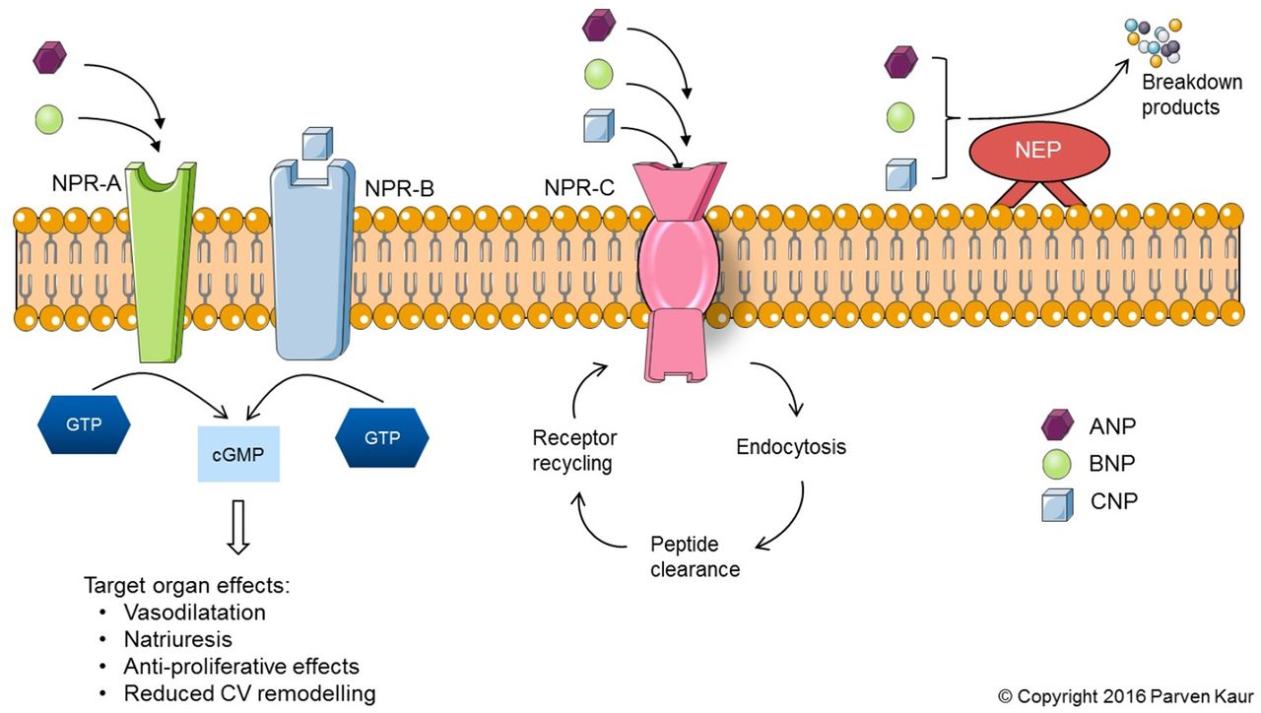
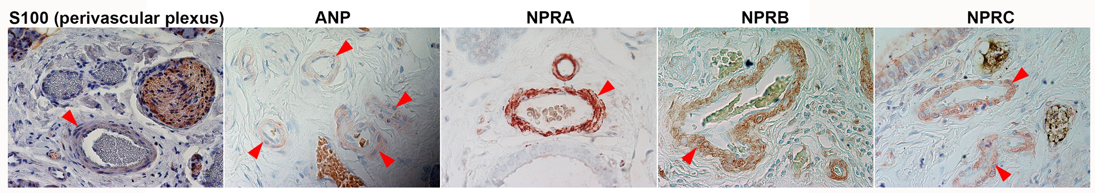
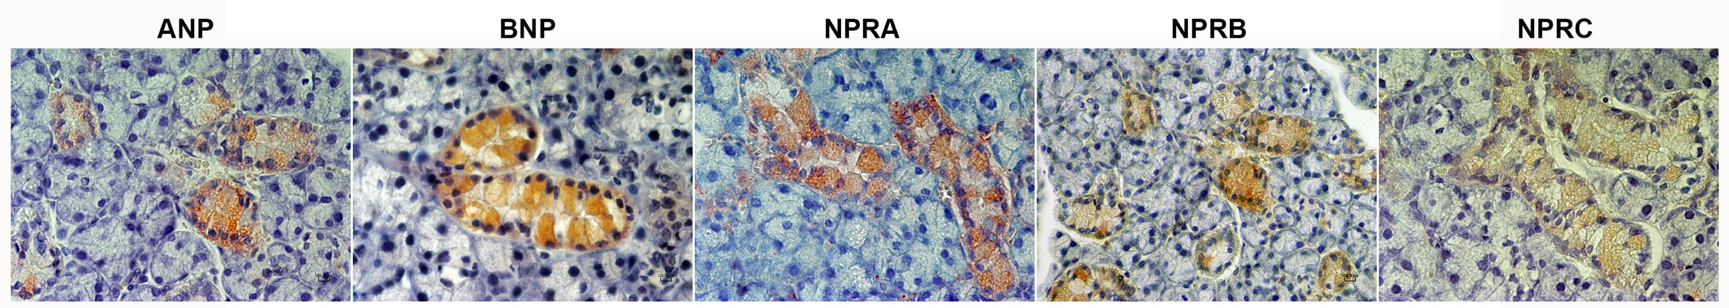
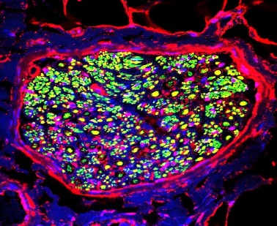
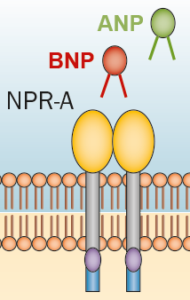
The natriuretic system in human and murine submandibular salivary glands in health and disease: insights from head and neck tumour cases
Alessandro Gulino✧, Araz Ahmed*, Beatrice Belmonte✧ Walter Arancio∞, Claudio Tripodo✧,Charbel Basset✢, Isabelle Miletich*, Abdo Jurjus‡ and Angelo Leone✢*
* Department of Craniofacial Development & Stem Cell Biology, Dental Institute, King’s College London, UK
✢ Department of Biomedicine, Neuroscience and Advanced Diagnostic, Section of Histology and Embryology, University of Palermo, Italy
✧ Tumor Immunology Unit, Department of Health Sciences, Human Pathology Section, School of Medicine, University of Palermo, Italy
‡ American University of Beirut, Department of Anatomy, Cell Biology & Physiology, Faculty of Medicine, Lebanon
∞Dipartimento STEBICEF Science, Chemical-Biological and Pharmaceutical Technologies
Introduction: The wide distribution of the atrial natriuretic peptide was paralleled by a similar presence of its receptors, an indication of the wide range of their biological effects beyond the control of the homeostatic process. This study depicts through immunohistochemical and molecular techniques the distribution and modulation of atrial natriuretic peptide and its receptors in human and murine salivary glands. It also highlights some clinical implications of ANP dysregulation.
Methods: Human SMG’s tissue samples were biopsied from normal (3), people with benign (2) or with malignant tumors (8). In addition, biopsies were taken from normal mice (10). They were processed by standard methods for routine microscopy and stained with hematoxylin and eosin or periodic acid Schieff. Other tissue sections underwent immunohistochemical staining with various antibodies targeting the ANP system.
Results: The expression of the ANP system and its receptors was detected in the stroma of the submandibular gland (SMG), on the secretory ducts, the nerves supplying the gland and on the smooth muscle of the respective blood vessels. Such an expression was intrinsic and not due to the ectopic blood vessels and nerves. The expression of ANP system receptors was also conserved in the SMG of normal mice. It was up-regulated in primary SMG tumors, in particular, early SMG carcinomas. In case of early stage carcinoma, an inflammatory reaction was detected which could have altered the nerve-parenchymal cell barrier and led to an overwhelming self-limited inflammatory reaction in both stroma and parenchyma. Along the same line, the distribution and up-regulation of the ANP system in the SMG could be a potential clinical marker for some pathologies. In brief, the high production of the ANP and the loss of its receptors in carcinoma could also indicate a paracrine effect of its production in the tumors.
Keywords: Atrial natriuretic peptide, Atrial natriuretic factor, Submandibular gland tumors, marker for oral carcinoma.
The natriuretic Peptide binding system
Abstract
Zois et al.,2014
1. The natriuretic peptide system is expressed in the ducts and peripheral nervous system of the human and mouse submandibular salivary gland
2. High levels of stromal NPRA protein in 2/11 submandibular glands of patients with oral squamous cell carcinoma (OSCC) may characterize early stages of malignancies in salivary glands.
Striated ducts
OSCC represents 90% of all oral malignancies and is associated with high morbidity and mortality, with an overall 5-year survival rate after treatment standing around 50%. At the time of diagnosis, in 43% of cases the disease has spread regionally, hence the need to find markers to identify the spread of the disease.
HUMAN
Nerves
Blood vessels
bv
D
D
D
D
D
Striated ducts
MOUSE
Figure 2. Immunostaining for NPRA was carried out in submandibular gland tissues from 11 patients diagnosed with OSCC originating from the oral mucosa. These salivary gland tissues were identified as non neoplastic by histopathology. Hematoxylin and eosin staining did not reveal significant histological differences between the SGs of these 11 patients. 2 out of 11 submandibular gland tissue samples showed high expression of NPRA protein in the stroma of the gland (352439 and 361522, red arrows) compared to expression of NPRA protein restricted to blood vessels (bv) and ducts (D) in other tissue samples (see 365501). NPRA levels of expression were undetectable in advanced carcinoma of the submandibular gland, suggesting high levels of NPRA protein may characterize an early-stage cancer.
Nerves and Parasympathetic ganglia
D
Figure 1. Immunostaining and immunofluorescence for ANP, BNP, CNP, three receptors NPRA, NPRB and NPRC and Tubulin-3β in human and mouse submandibular salivary glands. In humans and mice all components are expressed in the ductal network of the gland, where they may act in a paracrine or autocrine fashion to modulate gland function. We show for the first time that ANP, CNP and the three natriuretic receptors are expressed in the peripheral nervous system both in humans and mice, suggesting a conserved role for ANP as a neurotransmitter or neuromodulator. All components of the natriuretic system are also expressed in the blood vessel walls, where perivascular plexuses are found. Bv: blood vessel. qPCR for NPPA (encoding ANP) revealed the presence of NPPA mRNA in the human submandibular gland.
Figure 4. Nerve bundle within a human submandibular gland with NPRA in red and beta III Tubulin in green
Figure 3. Both ANP and BNP can bind to NPRA. In addition to high stromal NPRA protein expression in the septum and parenchyma of the submandibular gland of patient 361522, ANP was found to be ectopically expressed in some acinar cells (red arrowheads), while BNP expression was not changed. High NPRA expression in the stroma of the gland is not associated with increased vascularization or ectopic lymphatic vessels (data not shown).
3. NPPA (encoding ANP) is up-regulated in submandibular gland carcinoma
Identification of natriuretic peptides and receptors in human and murine salivary gland peripheral nerves implies biological effects beyond pressure-volume homeostasis for this peptide system.
Salivary gland carcinoma, similar to lung small cell carcinoma, exhibits higher levels of NPPA (gene encoding ANP).
Amongst 11 salivary gland samples with normal histology originating from patients with oral OSCC, 2 cases showed an increase in ANP and NPRA protein expression. Ectopic ANP and NPRA may characterize early stages of malignancies in salivary glands. We are currently investigating whether high NPRA protein expression correlates with the presence of inflammatory cells.
Figure 4. Each column corresponds to a distinct patient, with error bars representing the variation between the three technical replicates. Submandibular carcinomas have significantly higher levels of NPPA (gene encoding ANP) than control submandibular glands. This is in contrast with pleomorphic adenoma of the submandibular gland (benign tumors), which present lower levels of NPPA expression than control glands.
Conclusion
Specimens from patients were obtained from the archives of the Human Pathology Section, Department of Health Science, University of Palermo, Italy. All procedures were in accordance with the Helsinki Declaration.
Zois et al., 2014, Nature 11:403-412.

